Slide 1
Hexcute: A Compiler Framework for Automating Layout Synthesis in GPU Programs
Xiao Zhang, Yaoyao Ding, Bolin Sun, Yang Hu, Tatiana Shpeisman, Gennady Pekhimenko

Slide 2
Overview
Goal
Programming modern GPUs with less coding effort
Support new emerging deep learning operators in less amount of time
Key Ideas
A tile-level programming interface with explicit control
e.g. shared memory and register abstractions
A compiler framework for automating layout synthesis in GPU programs.
Key results
Achieve performance comparable to CUTLASS and FlashAttention 3, while reducing code size by 1.27-7.94x
Improve the complex operators like MoE and Scan by up to 6.46x compared to Triton

Slide 3
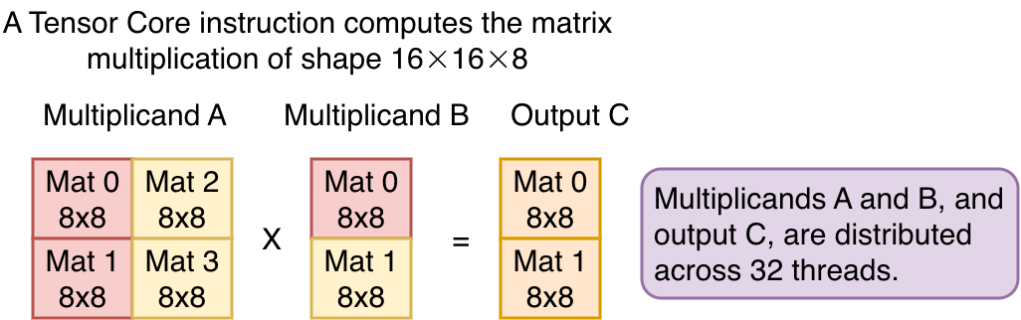
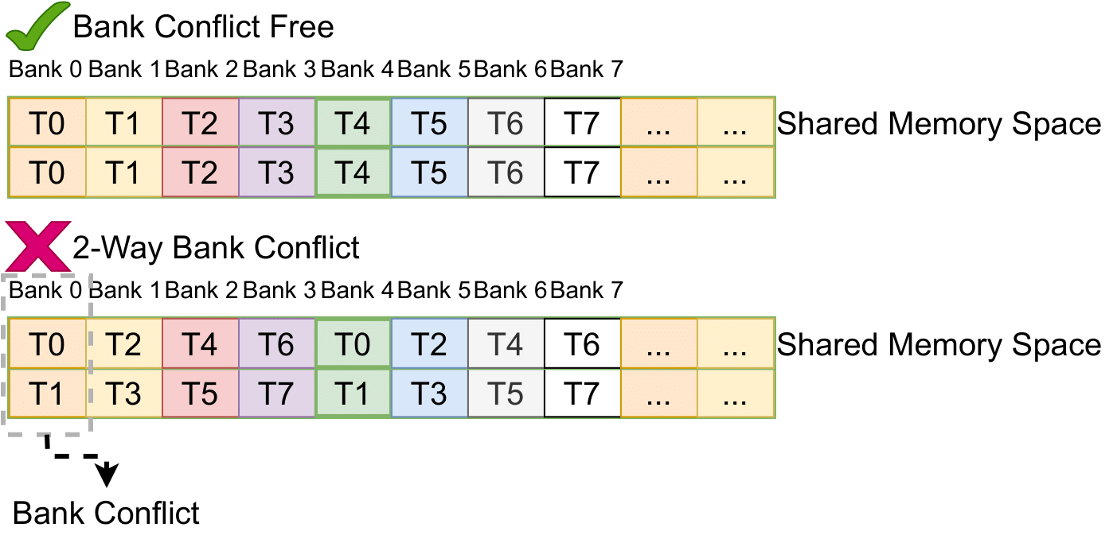
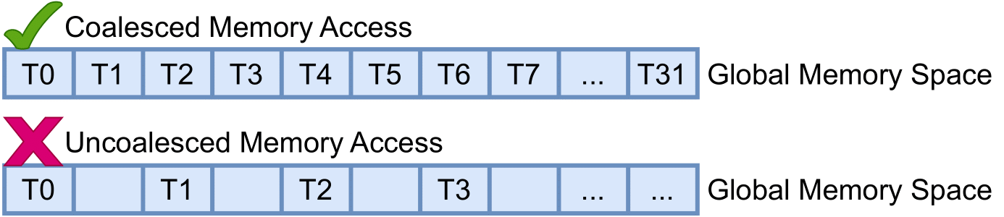
Motivation
Modern GPUs are becoming increasingly complex
Collective Tensor Core instructions: a group of threads working together to perform a computational task
Memory access pattern needs optimization:
Global memory access needs to be coalesced.
Shared memory memory access needs to be bank-conflict free.

Slide 4
Motivation
New deep learning algorithms require sophisticated kernel optimizations, including:
Weight-only quantization techniques
Mixed-type operators
Mamba model architecture
Scan operators
Linear attention mechanisms

Slide 5
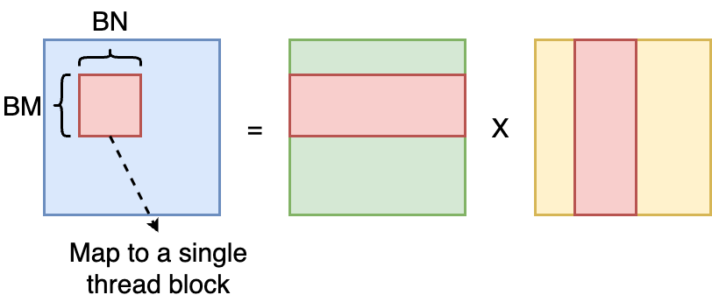
GPU Programming Model
Divide the computation into small tasks, and assign each task to a thread block on the GPU. The computational task assigned to a thread block is called a kernel.
A kernel operates on statically shaped tensors, known as tiles.
These tensors reside within the GPU memory hierarchy.

Slide 6
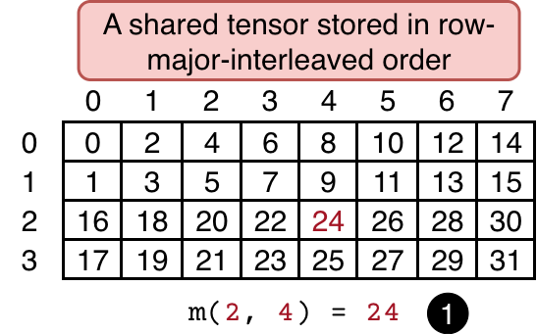
Shared memory tensors
A shared memory tensor is a data region within the on-chip memory hierarchy.
The data arrangement is defined by a mapping function that maps tensor coordinates to corresponding memory addresses.

Slide 7
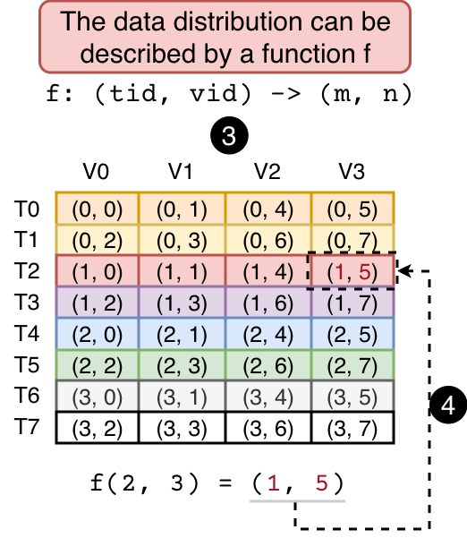
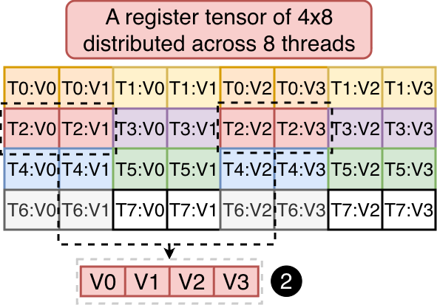
Register tensors
A register tensor is distributed across a group of threads.
Its distribution is defined by a mapping function that maps thread and value IDs to their logical positions within the tensor.

Slide 8
Tensor Layouts in GPU programs
Tensor layouts describe how tensors are mapped to GPU memory and threads.
Layouts are critical to GPU performance.
Data distribution affects whether global memory accesses are coalesced.
Memory arrangement determines which hardware instructions can be efficiently used.
We refer to the task of finding optimal layouts as the layout synthesis problem.

Slide 9
Challenges in tensor layout synthesis
Tensor layouts are general functions, creating a vast search space that is hard to explore exhaustively.
Heuristic-based approaches lack generality; new deep learning operators often require new heuristics.
Integer linear programming is inapplicable because layouts are functions rather than enumerable integer variables.

Slide 10
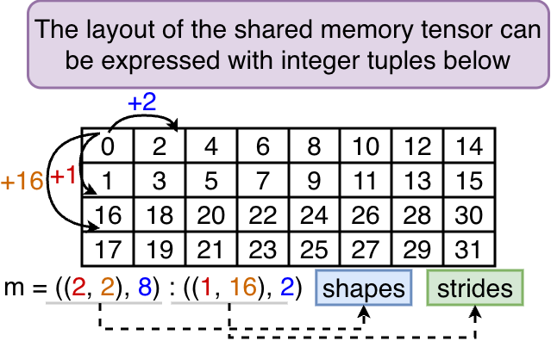
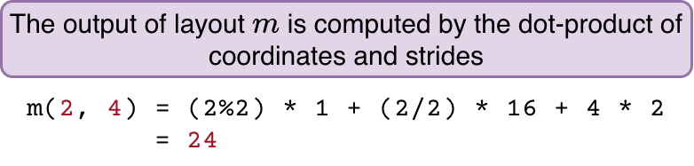
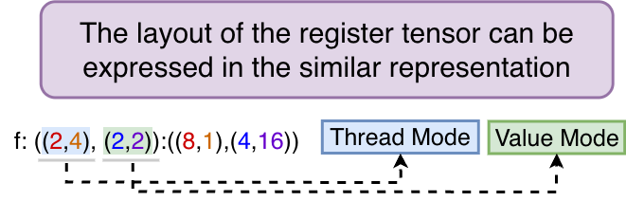
Low-level Programming Models
CuTe/CUTLASS and Hidet provide expressive layout abstractions for GPU programming.
The CuTe layout leverages hierarchical shapes and strides to represent complex tensor layouts.

Slide 11
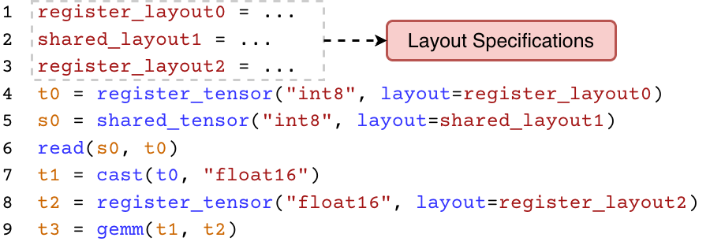
Low-level Programming Models
CuTe/CUTLASS and Hidet adopt a layout-centric programming model, where programmers first define tensor layouts and then implement the kernel.
This approach requires manual specification, making the process time-consuming and error-prone.

Slide 12
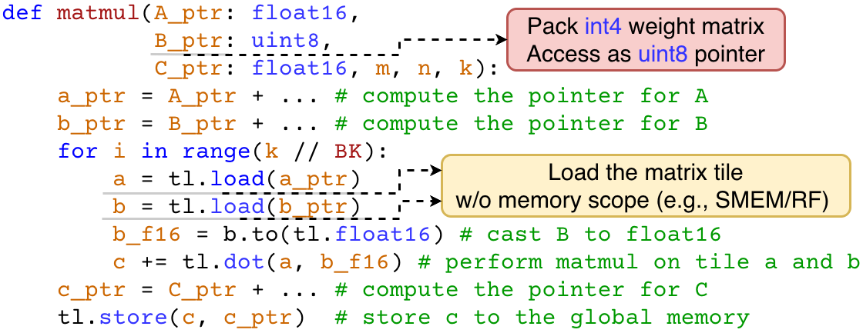
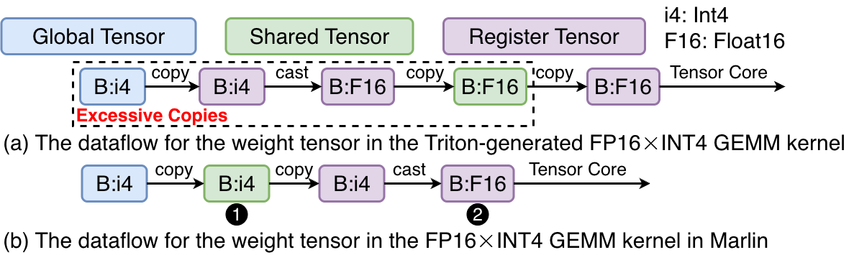
High-level Programming Models (Triton)
Triton automatically determines tensor layouts, dataflows, and pipelining strategies.
However, these heuristic-based strategies fail to generalize to complex operators, such as mixed-type GEMM operations.

Slide 13
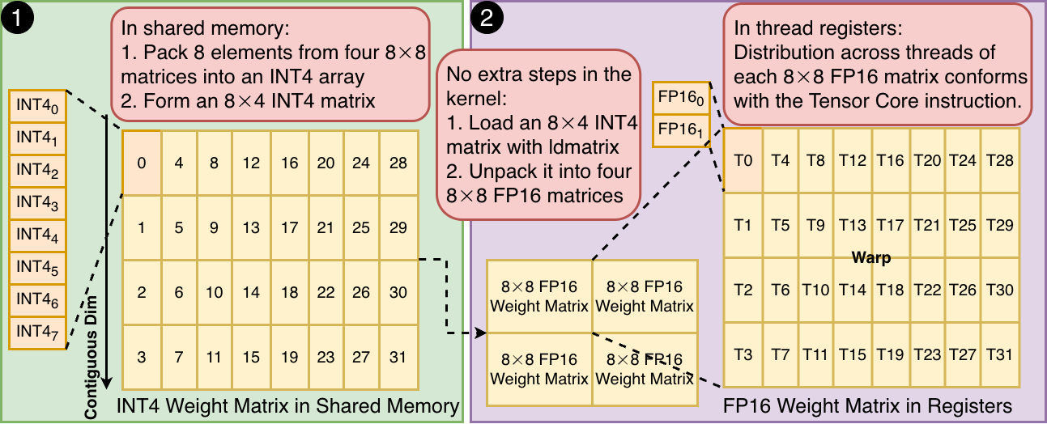
High-level Programming Models (Triton)
Triton automatically determines tensor layouts, dataflows, and pipelining strategies.
However, these heuristic-based strategies fail to generalize to complex operators, such as mixed-type GEMM operations.

Slide 14
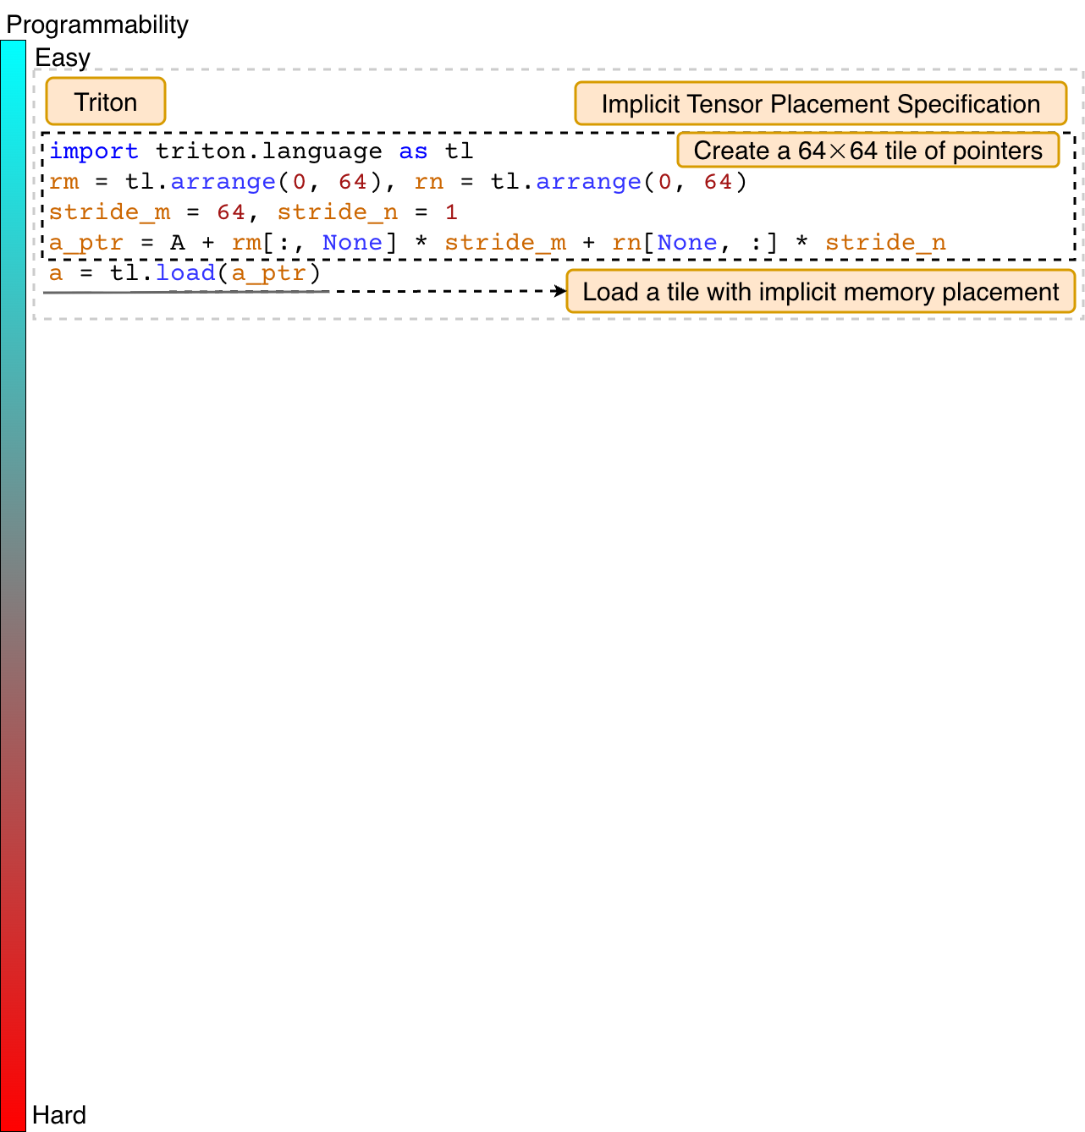
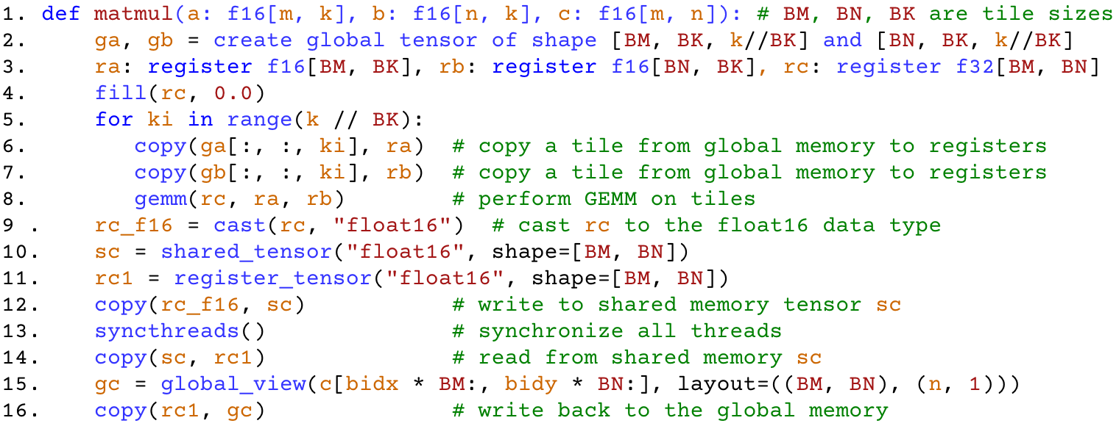
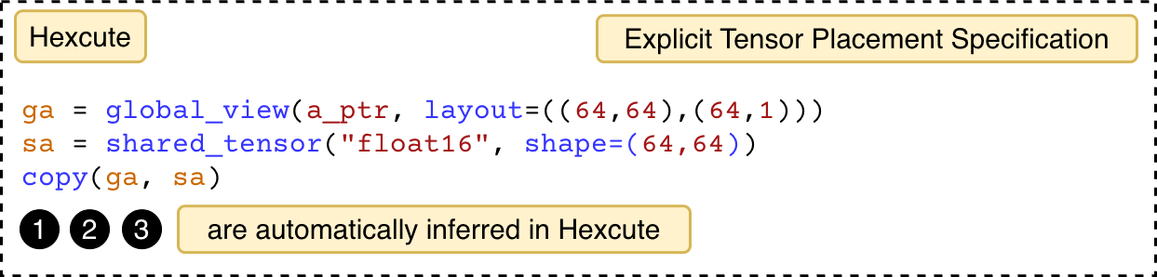
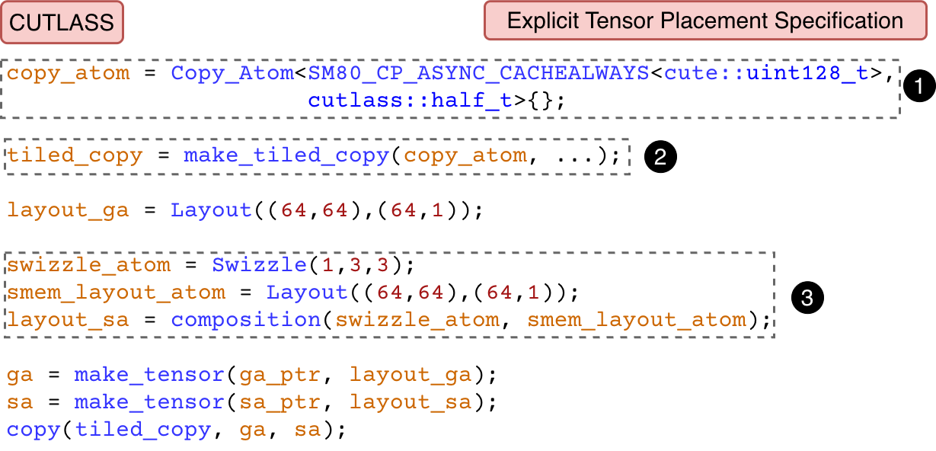
Hexcute Overview
A tile-based programming model that provides explicit control over computation and memory hierarchy.
A compiler framework that automates layout synthesis in GPU programs via constraint programming.

Slide 15
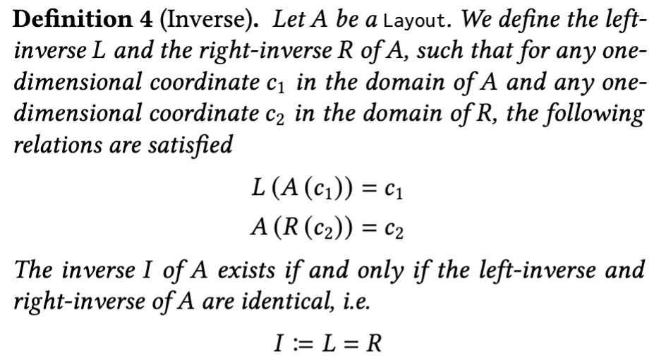
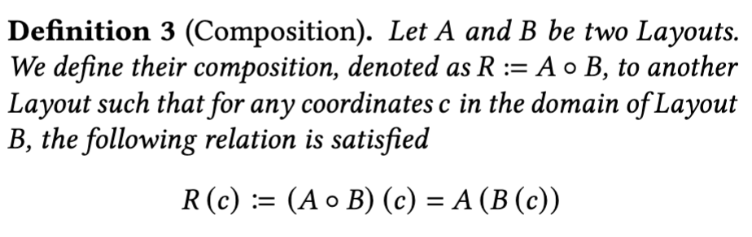
Key Ideas: Layout Model
Represent register tensor layouts using thread-value layouts, and represent shared memory layouts using hierarchical layouts.
The key difference between the CuTe layout and other layout systems is that CuTe supports algebraic operations, such as composition and inversion, in the sense of function composition and inversion.
This property enables us to formally reason about the layout synthesis problem.

Slide 16
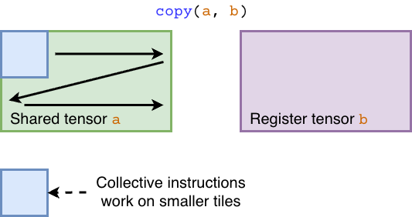
Key Ideas: Register Layout Constraint
In Hexcute, tile-level operations are performed on tensors.
These operations are implemented using collective instructions (e.g., Tensor Core instructions).
Collective instructions operate on smaller tiles within each tensor.

Slide 17
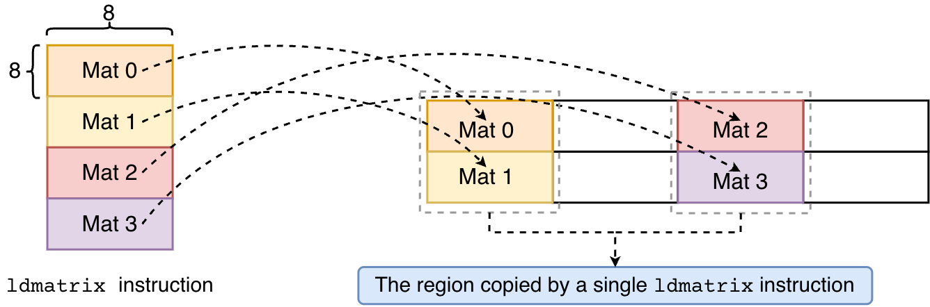
Key Ideas: Register Layout Constraint
The mapping from instruction tiles to operation-level tensors is defined by flexible functions, rather than fixed mappings.

Slide 18
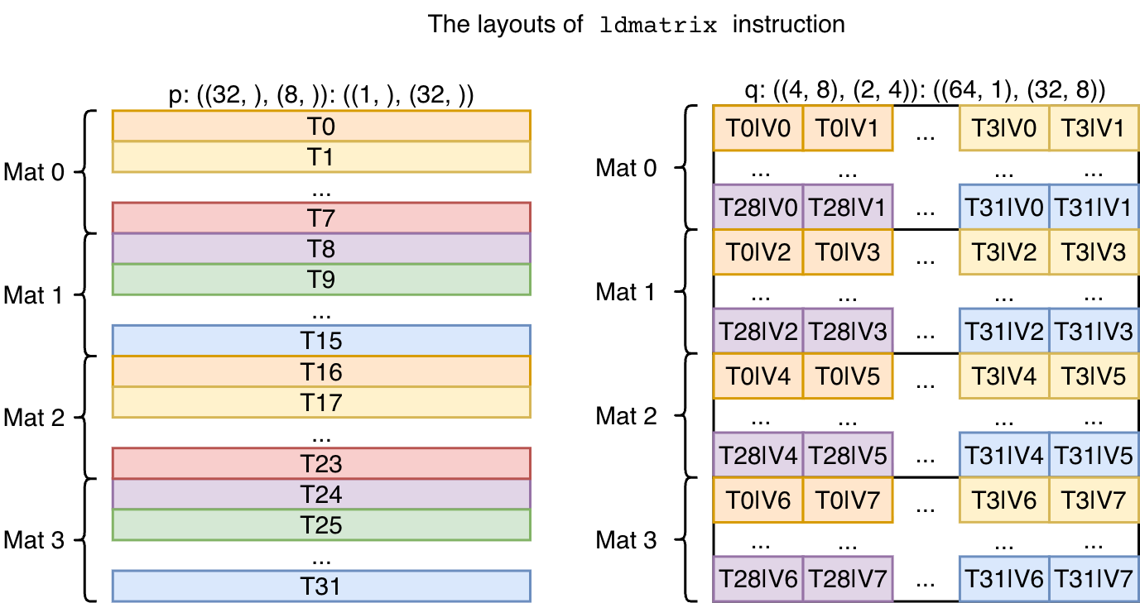
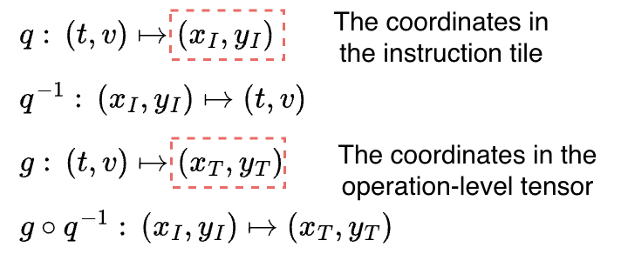
Key Ideas: Register Layout Constraint
Abstract collective instructions using thread-value layouts.
Construct mapping functions through layout composition and inversion.

Slide 19
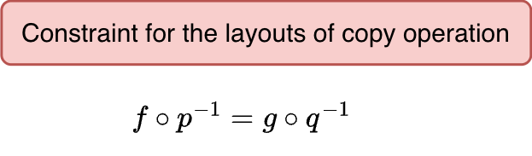
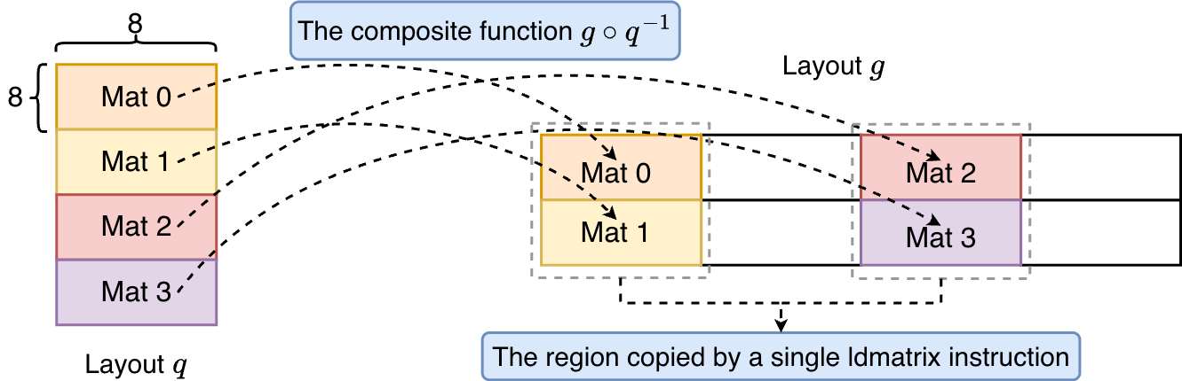
Key Ideas: Register Layout Constraint
Abstract collective instructions using thread-value layouts.
Construct mapping functions through layout composition and inversion.

Slide 20
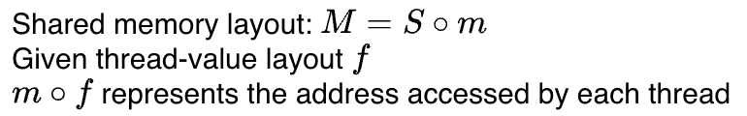
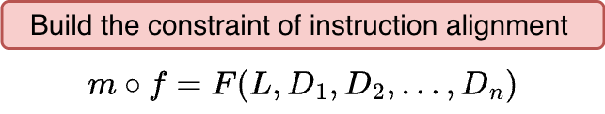
Key Ideas: Shared Layout Constraint
Represent the shared memory layout as the composition of a hierarchical layout (m) and a swizzle function (S).
The composition of layout m and the thread-value layout (f) defines the memory region accessed by each thread, constrained by the alignment requirements of the instruction.

Slide 21
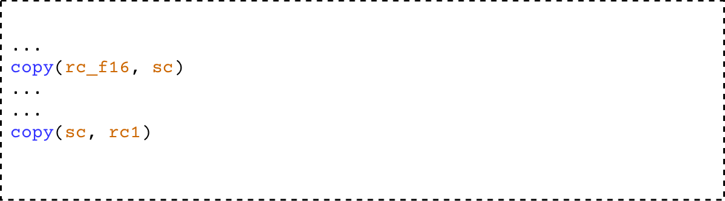
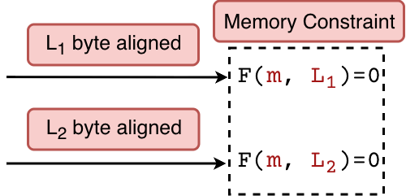
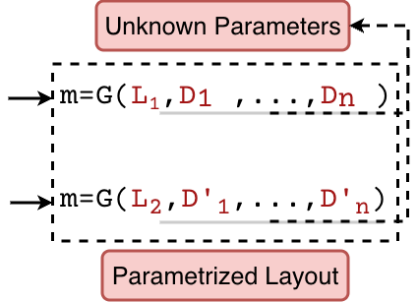
Key Ideas: Shared Layout Constraint
Build parameterized constraints for shared memory layouts.
Synthesize layouts by merging and resolving constraints.

Slide 22

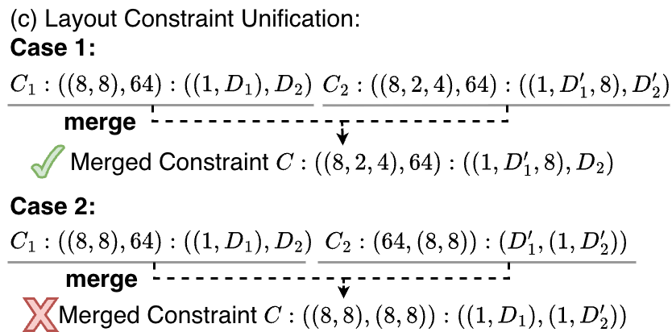
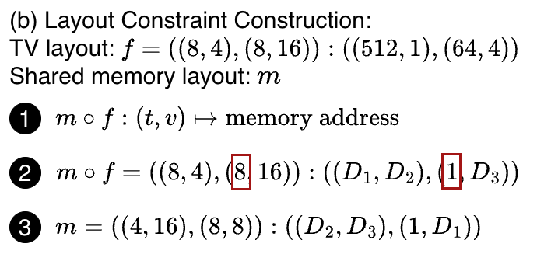
Key Ideas: Shared Layout Constraint
The constraint formalization of shared memory layouts

Slide 23
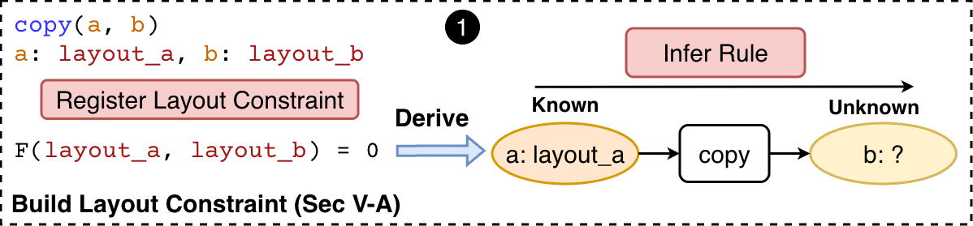
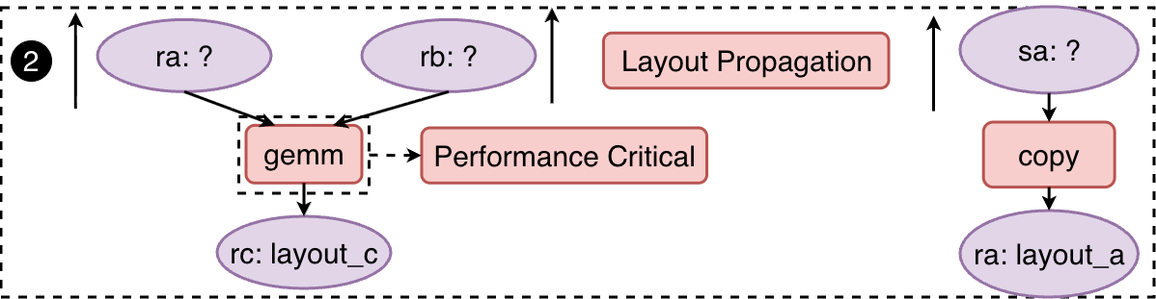
Layout Synthesis Algorithm
Build register layout constraints through layout composition and inversion.
Construct a DAG for the program and partition it into subgraphs bounded by shared memory reads and writes.
Propagate register layouts using constraints derived from anchor operators such as GEMM and copy operations.

Slide 24
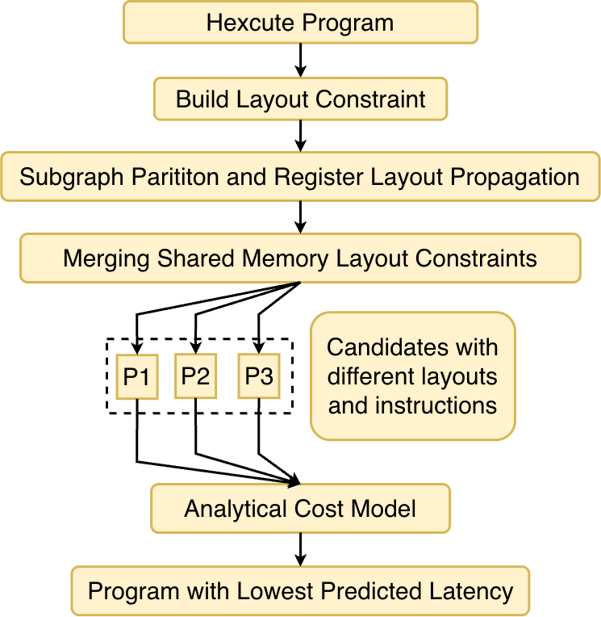
Layout Synthesis Algorithm
Build shared memory layout constraints by merging the constraints within each subgraph.
Use an analytical cost model to select the optimal program.

Slide 25
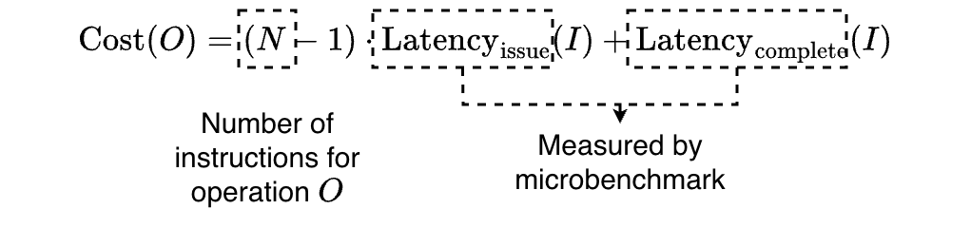
Analytical Cost Model
Cost of tile-level operations via microbenchmark
Estimate the cumulative latency of the operator sequence.
Consider the overlapping of memory and computation instructions. Copy operations can be on the flight.

Slide 26
Evaluation: Methodology
Hardware: NVIDIA A100 & H100 GPUs at 1.41GHz.
Baselines: cuBLAS, CUTLASS, FlashAttention 3, Triton, FlashInfer.
Metrics: performance, code size, end-to-end latency.

Slide 27
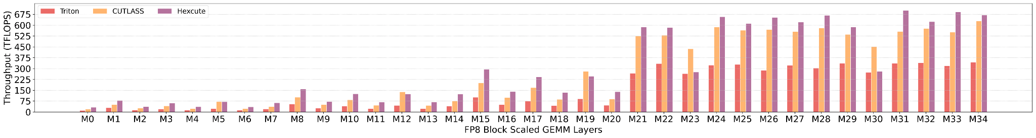
Evaluation: Block-scaled FP8 GEMM
Improve kernel performance by 1.25x on average compared to the CUTLASS kernel in vLLM.
Reduce the amount of code by 5x by removing heavy template specifications for layouts.

Slide 28
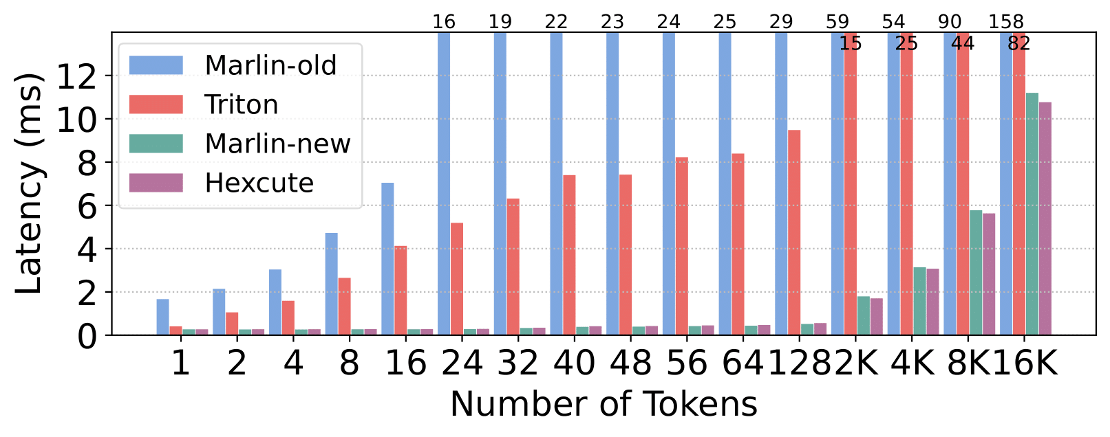
Evaluation: mixed-type MoE
Improve performance of the mixed-type MoE with 256 experts by 6.46x over Triton and 28.42x over Marlin-old.
Achieve approximately 96% of Marlin-new’s performance.
Reduce the code size of the Marlin kernel from 1,411 LoC to 341 LoC.

Slide 29
Evaluation: mixed-type MoE
Bytes per instruction in the Triton and Hexcute kernels with the same tile size.
Tensor | Triton (bytes) |  |  | Hexcute (bytes)
A | 16 (G2S) | 8 (S2R) |  | 16 (G2S) | 8 (S2R)
B | 1 (G2R) | 2 (R2S) | 8 (S2R) | 16 (G2S) | 8 (S2R)
scale | 16 (G2S) | 2 (S2R) |  | 16 (G2S) | 8 (S2R)
zero pointer | 1 (G2R) |  |  | 16 (G2S) | 8 (S2R)
G2S: Global memory to shared memory copy
G2R: Global memory to register file copy
S2R: Shared memory to register file copy
R2S: Register file to shared memory copy

Slide 30
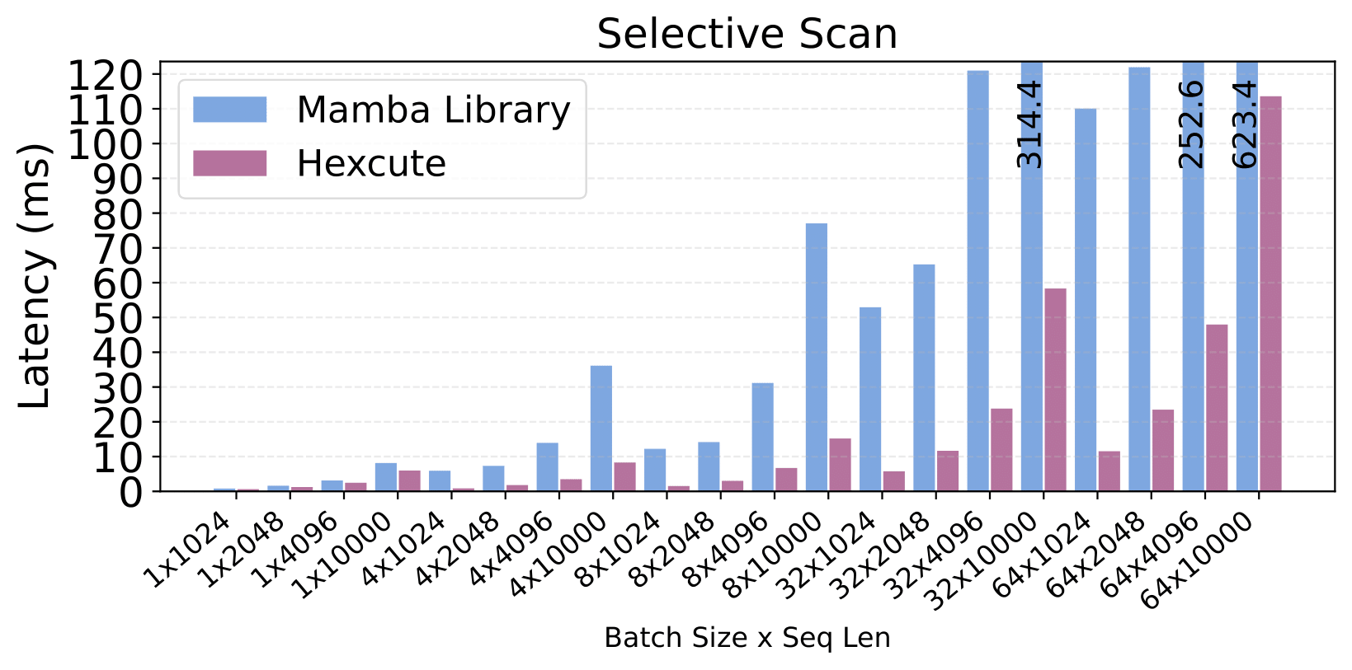
Evaluation: Mamba Scan
Improve the Mamba Scan kernel performance by 4.17× on average compared to the Mamba library.

Slide 31
Evaluation: Mamba Scan
Bytes per instruction in the Mamba CUDA kernel and the Hexcute kernel.
Tensor | Mamba (bytes) | Hexcute (bytes)
u | 2 (G2R) | 16 (G2S) | 16 (S2R)
Delta | 2 (G2R) | 16 (G2S) | 16 (S2R)
A | 4 (G2R) | 4 (G2S) | 8 (S2R)
B | 2 (G2R) | 16 (G2S) | 16 (S2R)
C | 2 (G2R) | 16 (G2S) | 16 (S2R)
z | 2 (G2R) | 16 (G2S) | 16 (S2R)
G2S: Global memory to shared memory copy
G2R: Global memory to register file copy
S2R: Shared memory to register file copy
The Hexcute kernel reduces 96% of memory instructions compared to the hand-written Scan kernel through optimized layout exploration and instruction selection.

Slide 32
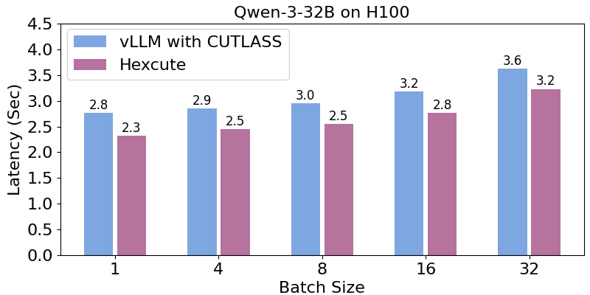
Evaluation: End-to-end
Replacing the CUTLASS block-scaled FP8 GEMM kernel with Hexcute achieves up to 1.16× performance improvement.
Latencies are measured for generating 100 output tokens from 100 input tokens.

Slide 33
Conclusion
We propose a tile-level programming model with explicit control over dataflow and pipelining strategies.
We develop a compiler framework, called Hexcute, to automate layout synthesis in GPU programs.
Achieve performance on GEMM and Attention comparable to CUTLASS and FlashAttention 3, while reducing code size by 1.27×–7.94×.
Improve performance by up to 6.46× compared to Triton on complex operators such as mixed-type MoE and Mamba Scan.

Slide 34
Q&A
Thank you!

