Slide 1
High-Level Optimization of Abstract Data Types
Anthony Hunt and Emil Sekerinski
McMaster University,
Hamilton, Canada
Notes:
Thank you for the introduction
Thanks for having me here today
Big idea:
Take a step back from popular low-level optimizations for matrix multiplications, specific architectures, and for specific tasks
Move from hardware directed optimizations to language directed optimizations
We instead look at optimizations for a higher level of abstraction
So that the implementation of a language (that is, the compiler) can decide the most efficient way of executing the underspecified semantics of abstract code
Abstract programs, under certain semantic restrictions, unlock entire classes of high-level optimizations
How do we do this?
Find something at the intersection between formal specification languages and high-level programming languages

Slide 2
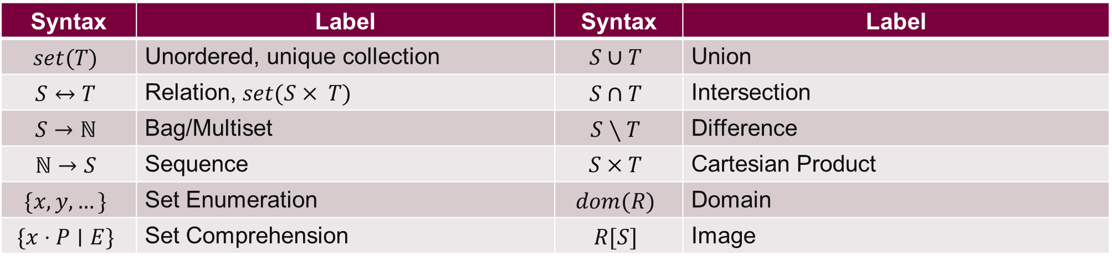
Programming With Abstract Data Types
System specifications use sets and relations
  Expressive and provable
Semantics from mathematics
Syntax | Label | Syntax | Label
$$set(T)$$ | Unordered, unique collection | $$S∪T$$ | Union
$$S↔T$$ | Relation, $set(S× T)$ | $$S∩T$$ | Intersection
$$S→ℕ$$ | Bag/Multiset | $$S∖T$$ | Difference
$$ℕ→S$$ | Sequence | $$S×T$$ | Cartesian Product
$$\{x, y, …\}$$ | Set Enumeration | $$dom(R)$$ | Domain
$$\{x⋅P∣E\}$$ | Set Comprehension | $$R[S]$$ | Image
Jean-Raymond Abrial. Modeling in Event-B: system and software engineering. Cambridge University Press, 2010.
David Gries and Fred Schneider. A Logical Approach to Discrete Math. Springer New York, 1993.
Notes:
High level programming languages often use collection data types like sets and relations
Behaviour is defined abstractly (ex. A set of items is unordered and unique)
Intended to be implementation independent
Most prevalent high level programming languages like python and javascript use these data types as essential core features
Programming is all about using and manipulating collections of objects
The highest level of programming is to mimic the semantics of discrete maths
See heavy usage in system specification languages
Formal specifications, as shown in the field of formal methods, enjoy the mathematical benefits of set theory for use in proving system correctness
Variety of languages: the B-method family (Event-B, B, Z), Alloy, UML
Express computational behaviour formally and concisely
Examples of some operations provided in the table

Slide 3
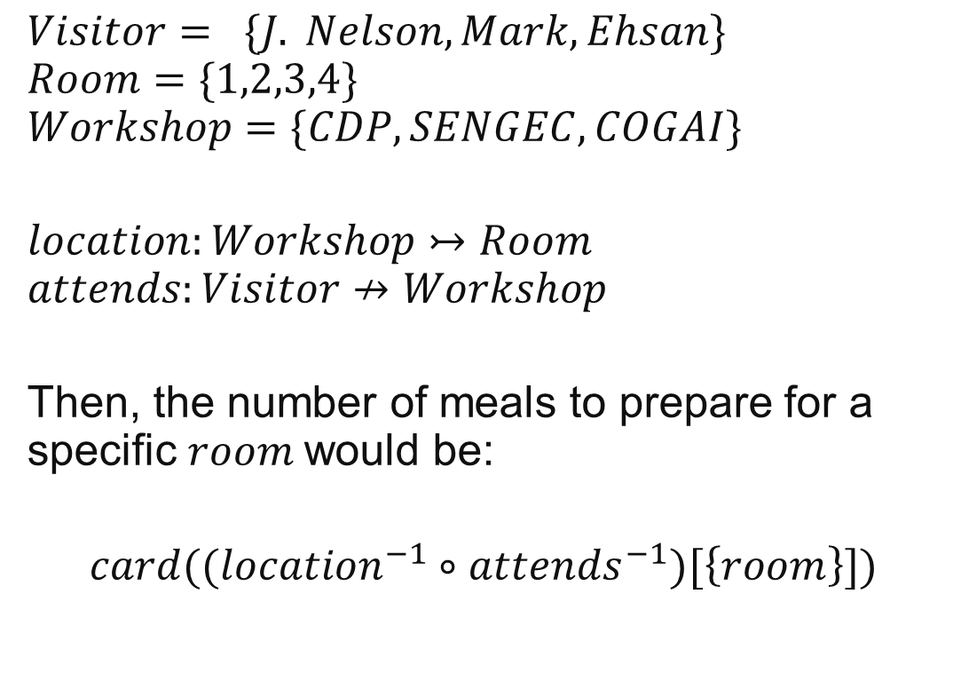
Example - Visitor Information System
$$Visitor= \{J. Nelson, Mark,Ehsan\}$$
$$Room=\{1,2,3,4\}$$
$$Workshop=\{CDP, SENGEC,COGAI\}$$
$$location:Workshop↣Room$$
$$attends:Visitor↛Workshop$$
Then, the number of meals to prepare for a specific $room$would be:
$$card((location^{−1}∘attends^{−1})[\left\{room\right\}])$$
Academics attend workshops throughout CASCON 2025
Every workshop must be held in one room
Visitors may attend at most one workshop at a time
Total Injective Function
Partial Function
Relational Image
Notes:
Let’s turn to an example:
Say we are an administrator for a conference like CASCON
We need a system to register attendees and allocate resources
Few rules to follow
Academics can attend several workshops
Every workshop must be held in one room
Visitors may attend at most one workshop at a time
Ex. “Mark” attends the “CDP 2025” workshop
The CDP workshop is located in hall D
What if the organizers decide to prepare meals for a specific room?
How many meals would they need?
We can model this with three sets
Visitor
Room
Workshop
Two relations
Location (a one-to-one functional relation)
Attends (partial function)

Slide 4
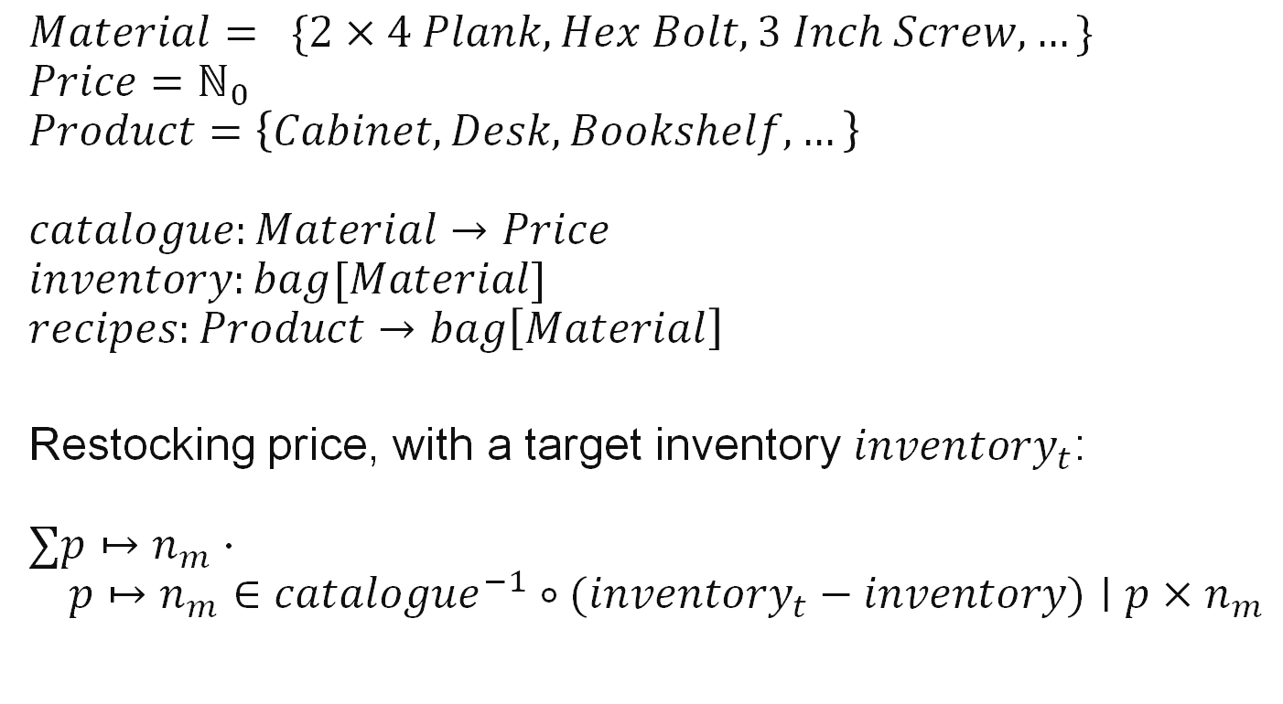
Example - Warehouse Inventory System
$$Material= \{2×4 Plank, Hex Bolt, 3 Inch Screw,…\}$$
$$Price=ℕ_{0}$$
$$Product=\left\{Cabinet, Desk, Bookshelf, …\right\}$$
$$catalogue:Material→Price$$
$$inventory:bag[Material]$$
$$recipes:Product→bag\left[Material\right]$$
Restocking price, with a target inventory $inventory_{t}$:
$$∑p↦n_{m}⋅ \\ p↦n_{m}∈catalogue^{−1}∘{(inventory}_{t} − inventory)∣p×n_{m}$$
Furniture material catalogue
Warehouse inventory
Product recipes
Equivalent to: $Material↛ℕ$
Bag Difference
Notes:
Track the flow of inventory within a build-it-yourself warehouse
3 Types of objects: Materials, prices, products
A catalogue that tracks the prices of various furniture materials
Warehouse inventory of materials
Recipe for creating products from some combination of materials
Bags are just relations from the domain of the underlying items to the natural numbers, counting the number of occurrences
Want to know:
Price of restocking the warehouse with a target inventory

Slide 5
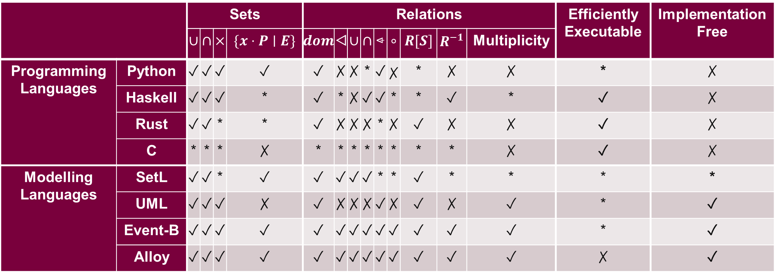
Abstract Data Types
In Programming and Modelling Languages
 |  | Sets |  |  |  | Relations |  |  |  |  |  |  |  |  | Efficiently Executable | Implementation Free
 |  | $∪$ | $∩$ | $×$ | $\{x⋅P∣E\}$ | $dom$ | ◁ | $∪$ | $∩$ |  | $∘$ | $R[S]$ | $R^{−1}$ | Multiplicity
Programming Languages | Python | ✓ | ✓ | ✓ | ✓ | ✓ | ✗ | ✗ | * | ✓ | ✗ | * | ✗ | ✗ | * | ✗
 | Haskell | ✓ | ✓ | ✓ | * | ✓ | * | ✗ | ✓ | ✓ | * | * | ✓ | * | ✓ | ✗
 | Rust | ✓ | ✓ | * | * | ✓ | ✗ | ✗ | ✗ | * | ✗ | ✓ | ✗ | ✗ | ✓ | ✗
 | C | * | * | * | ✗ | * | * | * | * | * | * | * | * | ✗ | ✓ | ✗
Modelling Languages | SetL | ✓ | ✓ | * | ✓ | ✓ | ✓ | ✓ | ✓ | * | * | ✓ | * | * | * | *
 | UML | ✓ | ✓ | ✓ | ✗ | ✓ | ✗ | ✗ | ✗ | ✓ | ✗ | ✓ | ✗ | ✓ | * | ✓
 | Event-B | ✓ | ✓ | ✓ | ✓ | ✓ | ✓ | ✓ | ✓ | ✓ | ✓ | ✓ | ✓ | ✓ | * | ✓
 | Alloy | ✓ | ✓ | ✓ | ✓ | ✓ | ✓ | ✓ | ✓ | ✓ | ✓ | ✓ | ✓ | ✓ | ✗ | ✓
Notes:
This table shows out-of-the-box support for set and relation types
Virtually every language offers the most common set operations
Most relation operations can be implemented through basic set operations, but we are looking for dedicated support
Ex. A set of tuples doesn’t really work
exposes the implementation of the relation
Inefficient membership operations
Programming languages
Sets: hashsets or tree-based sets
Relations: one-way hashmaps
Misnomer: Can only represent functional relationships (many-to-one), since duplicate hashmap keys with different values are not supported
Multiplicity of these relations cannot be stated within the type system (e.g. restricting the domain/range, determining injectivity or surjectivity, partiality)
Low level languages are focused on performance
C doesn’t really provide the programmer with any support
External libraries pick up the slack, but most C code uses concrete types (arrays, structs)
High level languages (like python) come close to offering the desired set and relation operations
Although programming languages offer set operations, they are naively implemented
Most programming language datatypes are focused on execution, close to hardware, and aren’t very suitable for modelling/proving
Modelling languages:
Modelling languages struggle with efficient execution support
Tools exist to execute specification languages:
ProB does work for Event-B, but does not make use of set theory for optimizations
A subset of UML can execute, but requires the help of lower-level constructs and struggles with purely theoretical relations
SetL uses value-based semantics
Results in a lot of copying – slow in practice, resulting in poor overall execution efficiency
Event-B or Alloy are good candidates for a language that optimizes set expressions

Slide 6
Goals
Syntax close to discrete mathematics
Simple, small, and usable
High-level set-theory optimization
Efficient in memory and time
Modelling Languages
Programming Languages
Notes:
We want: Expressiveness of modelling languages and efficiency of programming languages
What are we looking for in a model simulation language?
High level syntax close to discrete mathematics
Event-B, Alloy, SetL
Formal methods experts can prove programs correct
Simple, small, and usable language
Model concepts on set-theory
Python-like approachability
Use knowledge of set theory to optimize expressions at a high level
Rewrite the Abstract Syntax Tree (AST) of a parsed language using set theory semantics
Each rewrite rule can be proven correct within the confines of the language
Optimize expressions one AST node at a time
Highly performant in speed and efficient when using memory
Data types can be selected at compile time to best suit the operations performed within its lifetime
Ex.
Bitsets for small numerical ranges
Trie structures for sparse sets of data (either strings or numbers)
The compiler should select the most optimal execution given the behavioural guidelines
Compiler frameworks like MLIR, LLVM are already excellent at low-level optimizations
Allows us to focus on high level set optimizations

Slide 7
Related Work
ProB animation engine for Event-B [1]
GHC rewrite rules [2]
Rewrite systems for set-theory focused optimization [3,4,5]
SETL data type lowering from abstract types to suitable concrete structures [6,7]
[1] Michael Leuschel. Programming in B: Sets and Logic all the Way Down. In: LPOP 2022.
[2] Simon Peyton Jones, Andrew Tolmach, and Tony Hoare. Playing by the rules: rewriting as a practical optimisation technique in GHC. In: 2001 Haskell Workshop. ACM SIGPLAN. Sept. 2001.
[3] Maximiliano Cristia and Gianfranco Rossi. {log}: Programming and Automated Proof in Set Theory. In: LPOP 2022.
[4] Elco Visser, Zine-el-Abidine Benaissa, and Andrew Tolmach. Building program optimizers with rewriting strategies. In: ICFP 1998.
[5] Douglas R. Smith and Stephen J. Westfold. Transformations for Generating Type Refinements. In: FM 2019.
[6] Edmond Schonberg, Jacob T. Schwartz, and Micha Sharir. 1979. Automatic data structure selection in SETL. In: POPL 1979.
[7] Stefan M. Freudenberger, Jacob T. Schwartz, and Micha Sharir. Experience with the SETL Optimizer. Association for Computing Machinery, 1983
Notes:
B or Event-B, through the ProB tool, can be used for animating specifications [Leuschel 22]
B is designed as a specification language for use with
Formal methods
Provable, Safety critical
Syntax close to discrete math
Slow execution speed
ProB is a model checker first and foremost
Used for debugging, teaching,
Not intended for deployment, but
In the 2022 LPOP workshop, Leuschel talked about increasing efficiency as an execution language
GHC uses rewrite rules to optimize Haskell functions [Jones, Tolmach, Hoare 01]
These rules could be used to express the flavour of set optimizations we are currently exploring
But extension of syntax for use with sets may be difficult
Less control over the entire compilation process
Functional style tends to focus on handling algebraic data types (eg. Linkedlist flavour of sequences)
To implement these optimizations, languages have made use of rewriting rules
Allows optimizations to be proved in bite sized steps
But these languages are focused on satisfiability, model checking, and proving rather than execution
Never in a setting intended for use as a programming language
Execution secondary to constraint solving, for example
SETL uses automatic data type lowering for sets
Bitsets for sets with a small range
Can optimize sparsely populated data structures
But only focuses on efficient representation of data and copying reduction, rather than reducing the operations themselves
Hashing (fast lookup, addition, membership) vs tree sets (log n for most ops, but keeps implicit ordering, ex. When working with integers)
We have done preliminary exploration of roaring bitsets to better accommodate larger domains
SetLog, constraint/satisfiability solver language that uses rewrite rules: https://www.clpset.unipr.it/setlog.Home.html, found in LPOP proceedings 2022 https://drive.google.com/file/d/1pS0sKhrG9HuM82JMsm5giadagjmTfNQ0/edit
Intended for proofs

Slide 8





Optimizing Abstract Data Type Operations (in Python)
$$(S∪T)∩V$$
$$\left(S∩V\right)∪(\left(T∖S\right)∩V)$$
# Python translation:
ret = set()
for x in S:
ret.add(x)
# Step 1: len(ret) == len(S)
for x in T:
ret.add(x)
# Step 2: len(ret) <= len(S) + len(T)
for x in ret:
if x not in V:
ret.remove(x)
# Step 3: len(ret) <= len(V)
# New Python translation:
ret = set()
for x in S:
if x in V:
ret.add(x)
# Step 1: len(ret) <= min(len(S), len(V))
for x in T:
if x not in S and x in V:
ret.add(x)
# Step 2: len(ret) <= min(len(S) + len(T), len(V))
What if $len\left(S\right)+len\left(T\right)>len\left(V\right)?$
$ret$ never grows larger than needed
Notes:
So what do we mean by operation optimizations?
One of the most popular and well-supported languages for abstract data types (sets, lists, dictionaries)
Look at example expression (S | U) & V
Python evaluates this to naïvely constructed loops of set operations
Note that the length (or cardinality) of the result set after step 3 may not depend on either S or T
Especially not the sum of S and T’s lengths, as in step 2
We also need to remove elements that have already been added to the return set
So what can we do?
In a pure set-theory world, we can rearrange the initial expression to something like:
<click>, distributing the V and eagerly restricting the size of T
Although the expression is longer, the translation is more time and memory efficient
Now, the result set never grows larger than the minimum: the size of V
The add function also does not need to implicitly check for membership inside of ret
we add the if statement “x not in S” to explicitly and eagerly check membership validity
Might unlock more optimizations later in the compilation pipeline
Note that we assume S and T are smaller than V, there is an alternative optimization in the case where V is smaller
We know what kind of optimizations we want to make: high level, set theory based operation simplification.
NOTE: This does not necessarily mean eliminating operations, but instead rewriting terms towards a few atomic actions
In the previous example, we expanded the number of operations from 2 to 4, but eliminated an entire superfluous loop
Limitations that prevent Python from optimizing set-oriented expressions:
Procedure side effects (e.g. printing elements in a list via a comprehension
Short circuiting behaviour
Results in larger-than-necessary intermediate set constructions

Slide 9
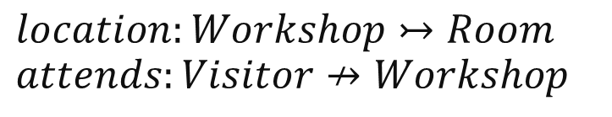
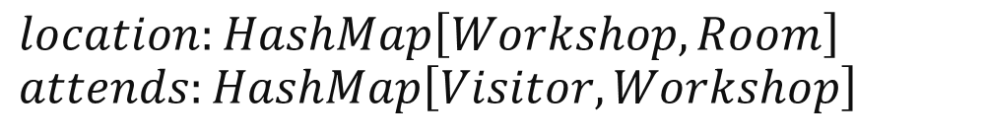
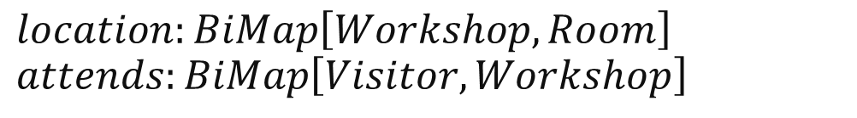
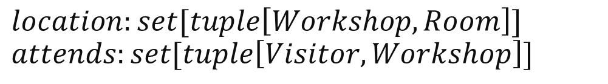
Concrete Data Types of the Visitor Information System
$$location:set[tuple\left[Workshop,Room\right]]$$
$$attends:set[tuple\left[Visitor,Workshop\right]]$$
$$location:Workshop↣Room$$
$$attends:Visitor↛Workshop$$
$$location:BiMap\left[Workshop,Room\right]$$
$$attends:BiMap\left[Visitor,Workshop\right]$$
$$location:HashMap\left[Workshop,Room\right]$$
$$attends:HashMap\left[Visitor,Workshop\right]$$
Notes:
So we have set theory semantics that allow us to freely manipulate expressions in order to achieve some target properties
That’s only one half of the story – what properties doe we actually want to achieve?
Depends on the underlying concrete representation for an abstract type
Here we provide 3 options for the visitor information example relations
Set theory states that these are just sets of tuples
HashMaps are efficient in programming languages but restrictive in their multiplicity
Ex. Cannot represent one-to-many relations
Bidirectional multimaps use two underlying hashmaps to allow for many-to-one and one-to-many relationships
Can also contain many-to-many relationships, although these are less efficient
Other data types may be considered as needed
but the program must be aware of these choices
And their pros/cons before making a concrete choice

Slide 10
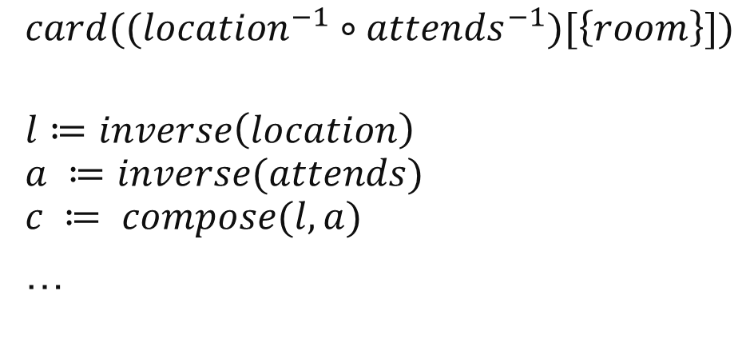


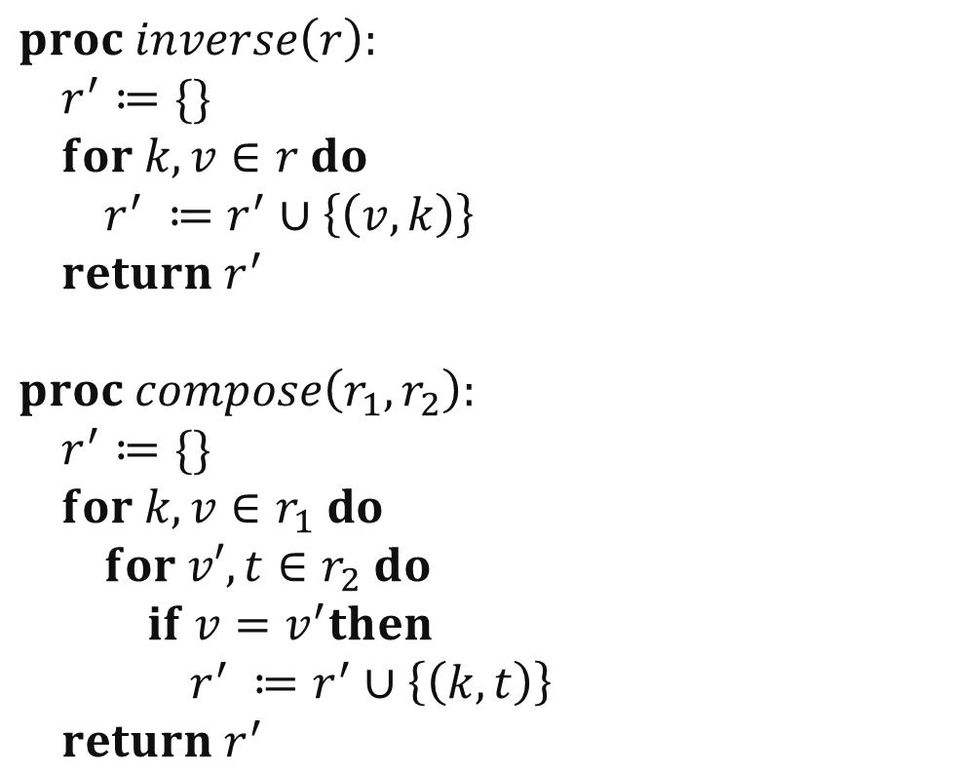
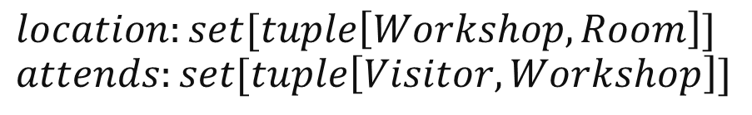
Naïve Implementation of the Visitor Information System
Library
Concrete Types
$$proc inverse\left(r\right): \\ r^{′}≔\{\}$$
$$for k,v∈r do \\ r^{′} ≔r^{′}∪\left\{\left(v,k\right)\right\} \\ return r^{′}$$
$$proc compose\left(r_{1},r_{2}\right): \\ r^{′}≔\{\}$$
$$for k,v∈r_{1} do \\ for v′,t∈r_{2} do \\ if v=v^{′}then \\ r^{′} ≔r^{′}∪\left\{\left(k,t\right)\right\} \\ return r^{′}$$
$$location:set[tuple\left[Workshop,Room\right]]$$
$$attends:set[tuple\left[Visitor,Workshop\right]]$$
Runtime: $O(n)$
Memory: up to $O(n)$
Imperative Interpretation
$$card((location^{−1}∘attends^{−1})[\left\{room\right\}])$$
$$l≔inverse\left(location\right) \\ a ≔inverse(attends) \\ c ≔ compose(l,a)$$
…
Runtime: $O(n^{2})$
Memory: $O(n)$
Notes:
Lets say we give the visitor information system specification to a mathematician who may not necessarily know the efficiency tradeoffs between the three types
They know that relations are sets of tuples, and concretizes the types accordingly
The imperative program for the given expression would first evaluate the highest precedence operators (inverse)
And continue expanding the program
Now, the library functions for sets of tuples must be defined as on the right side
We must iterate over the inputs any time we want to do anything, since there is no “lookup” function as in hashmaps
The composition function makes this calculation take n^2 time
But we can do better…

Slide 11
Designing Optimizations
Set theory semantics for optimizations
Strong type system with refinements
Rewrite system:
  Simplify operations
  Select concrete data representations from refined types
  Generate efficient code for every concrete representation and operation sequence
Notes:
We have the why, but:
How can we make these sorts of optimizations? What are the necessary ingredients?
First, follow set theory as closely as possible to harness the countless theorems available from mathematics
Semantics WILL diverge from programming languages
Ex. Programming languages use short circuiting ANDs, but we will need the freedom to manipulate the operands based on commutativity
Because the order of operand evaluation is no longer guaranteed:
Either need to recover from exception throwing operands (in a sense, reverse short circuiting)
Or evaluate all arguments (which loses all benefits of short circuiting)
Second, a strong type system with data type refinements
To make good choices on the representation of abstract data, we need to know as much about the type of data as possible
For example, performing an element lookup on a one-to-one relation may not need the iterative indexing that a one-to-many lookup would require
Dependent types may creep in to the type system, but only a very basic version
Ex. If a set of numbers has a known range and is total, finding the minimum/maximum becomes much easier
Our concern: How will these refined types interact with one another when operated on
Third, our optimizer: a rewrite system to implement these simplifications and lower abstract data types to efficient implementations
Involves manipulations of set operations based on theory
Implementation/representation selection (likely done with ad-hoc knowledge based on refined type data)
Requires liveliness analysis to see which operations will be used throughout an object’s lifetime
Multiple code generating backends for each implementation

Slide 12
Term Rewriting for Hash-based Sets and Relations
Comprehension Construction
Generator Selection
Loop Lowering
Relational Subtyping Loop Simplification
Loop Code Generation
Replace and Simplify
Notes:
Today, we show a series of term rewriting optimization passes that can work on any set/relation
Using type refinements will yield more optimal operator algorithms and underlying data structures
but we focus on optimizing operations that use hash sets and bi-directional hashmaps
Hash based sets and relations are the most generic
Other datatypes may be better suited for different contexts
Ex. Memory compaction, union find data structures, etc.

Slide 13


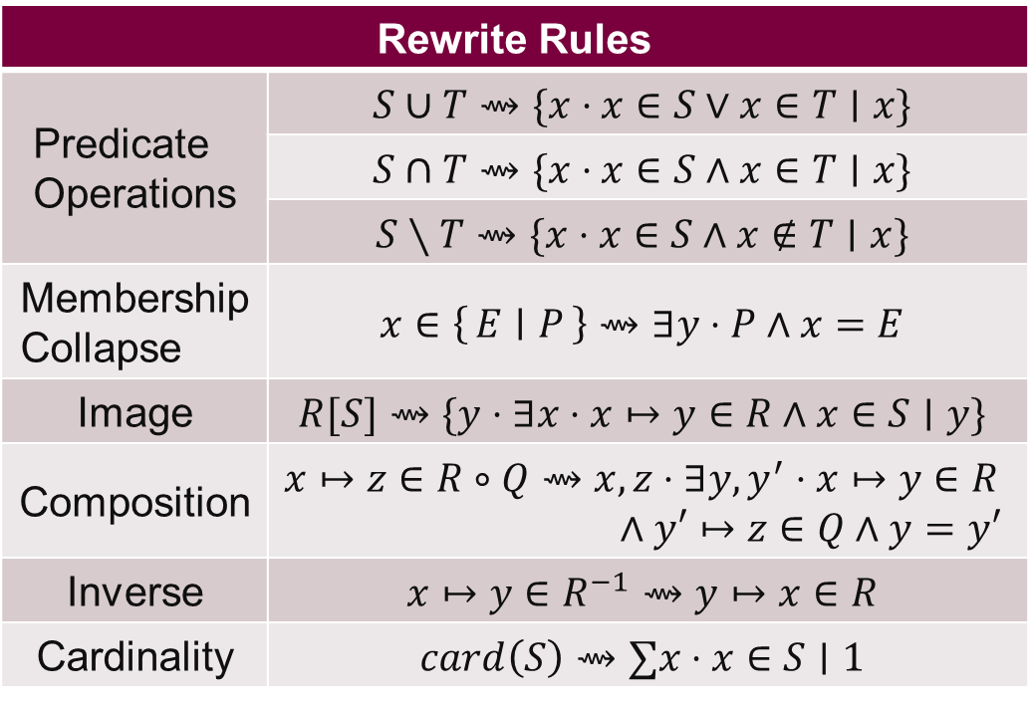
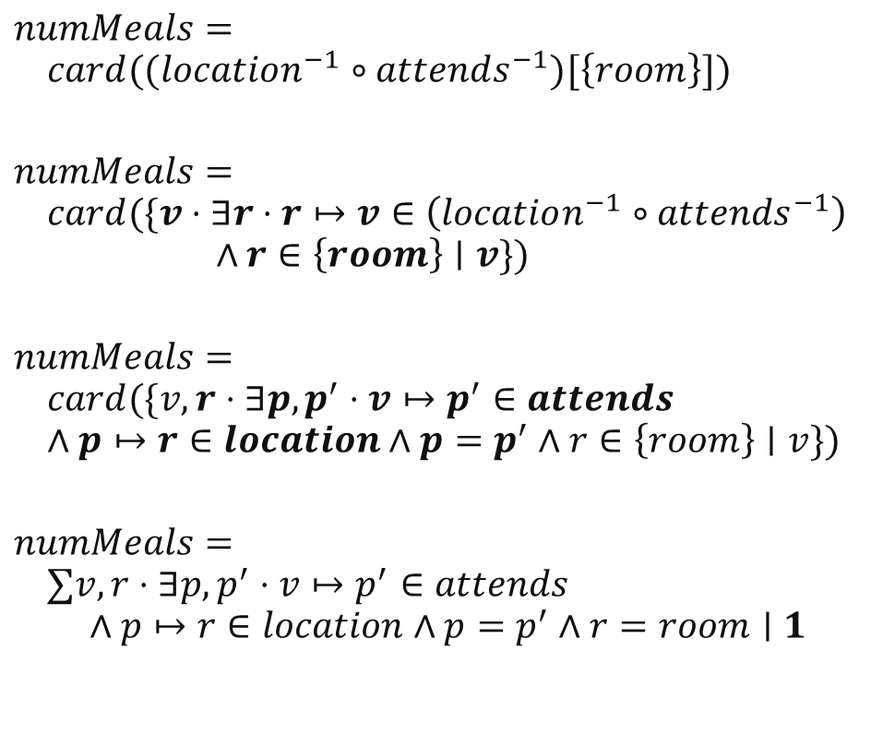
Phase 1: Set Comprehension Construction
Set-typed variables and literals are decomposed into set comprehensions
$$Workshop↣Room$$
$$Visitor↛Workshop$$
Rewrite Rules
Predicate Operations | $$S∪T⇝\{x⋅x∈S∨x∈T∣x\}$$
 | $$S∩T⇝\{x⋅x∈S∧x∈T∣x\}$$
 | $$S∖T⇝\{x⋅x∈S∧x∉T∣x\}$$
Membership Collapse | $$x∈\left\{E ∣ P\right\}⇝∃y⋅P∧x=E$$
Image | $$R[S]⇝\{y⋅∃x⋅x↦y∈R∧x∈S∣y\}$$
Composition | $$x↦z∈R∘Q⇝x,z⋅∃y,y^{′}⋅x↦y∈R \\ ∧y′↦z∈Q∧y=y′$$
Inverse | $$x↦y∈R^{−1}⇝y↦x∈R$$
Cardinality | $$card\left(S\right)⇝∑x⋅x∈S∣1$$
$$numMeals= \\ card((location^{−1}∘attends^{−1})[\left\{room\right\}])$$
$$numMeals= \\ card(\{v⋅∃r⋅r↦v∈\left(location^{−1}∘attends^{−1}\right) \\ ∧r∈\left\{room\right\}∣v\})$$
$$numMeals= \\ card(\{v,r⋅∃p,p^{′}⋅v↦p^{′}∈attends \\ ∧p↦r∈location∧p=p^{′}∧r∈\left\{room\right\}∣v\})$$
$$numMeals= \\ ∑v,r⋅∃p,p^{′}⋅v↦p^{′}∈attends \\ ∧p↦r∈location∧p=p^{′}∧r=room∣1$$
Image
Composition, Inverse
Cardinality, Membership
Post-condition:
All set-like terms must be comprehensions
Notes:
Basic set and relation operators
Intuition: All set-like variables and literals are decomposed into set comprehensions
Collapse number of nested comprehensions where possible
After this phase, all set-like terms are in comprehension form
All set operators have been lowered into Boolean predicate equivalents
Example:
As we present this rewrite system, we will be applying each phase of rules in the example at the bottom right-hand corner
This is the previously seen visitor info system, where a workshop’s organizers wish to calculate the number of meals to prepare
Applying the rules:
Break down image, inverse, composition, and cardinality operators into a sum quantification with two bound variables and a large AND predicate

Slide 14
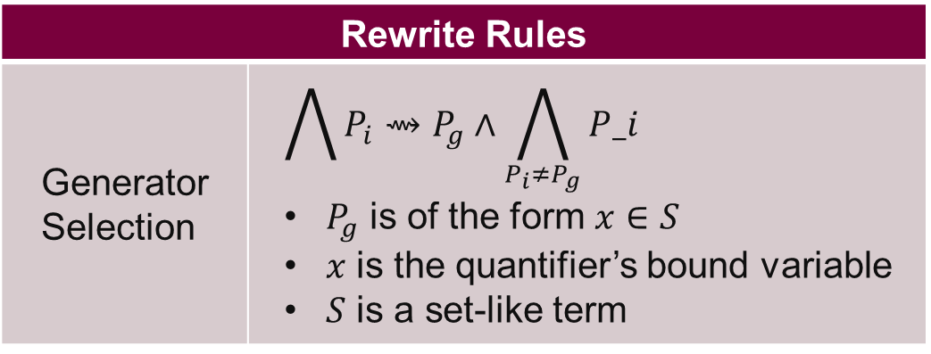
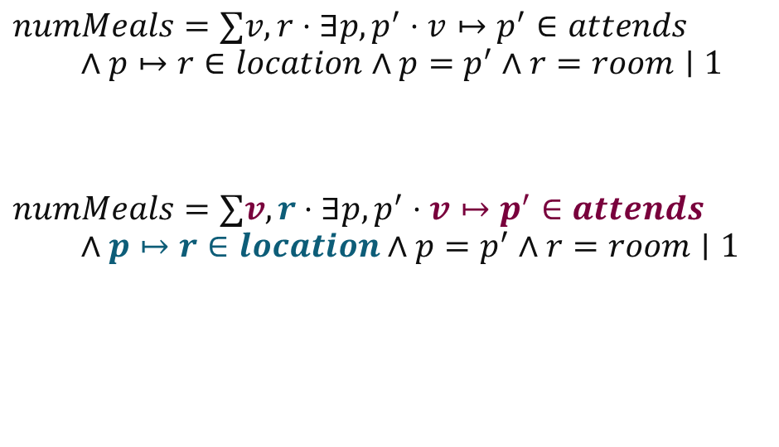
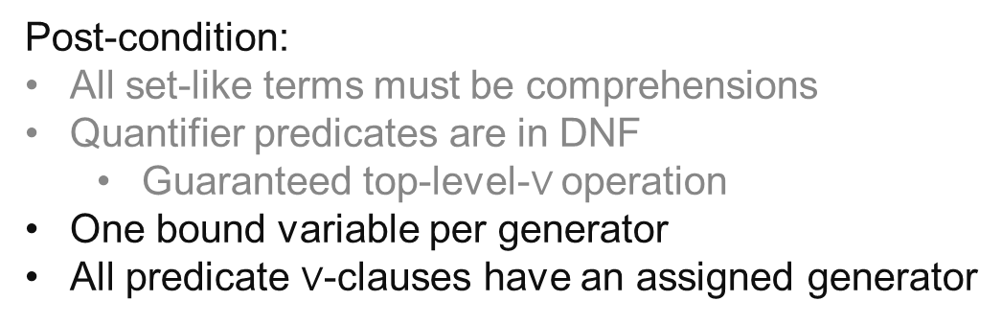
Phase 2: Generator Selection
Selecting element generators for use as iterables in generated for-loops
Rewrite Rules
Generator Selection | $$\bigwedge{P_{i}}⇝P_{g}∧\bigwedge_{P_{i}≠P_{g}}{P_i}$$ $P_{g}$ is of the form $x∈S$ $x$ is the quantifier’s bound variable $S$ is a set-like term
In the case of multiple candidate generators, selection is based on heuristics
$$numMeals=∑v,r⋅∃p,p^{′}⋅v↦p^{′}∈attends \\ ∧p↦r∈location∧p=p^{′}∧r=room∣1$$
$$numMeals=∑v,r⋅∃p,p^{′}⋅v↦p^{′}∈attends \\ ∧p↦r∈location∧p=p^{′}∧r=room∣1$$
Generator Selection
Post-condition:
All set-like terms must be comprehensions
Quantifier predicates are in DNF
  Guaranteed top-level-$∨$ operation
One bound variable per generator
All predicate $∨$-clauses have an assigned generator
Notes:
We know that these quantifiers must eventually be lowered into for loops
But we must choose the correct iterable (of form x in set)
Generator Selection is only valid inside a quantifier’s predicate
For now we say any iterable is sufficient, although in implementation we use heuristics to make an informed decision
Ex. Iterate over the smaller of two sets when both candidate generators are valid
Ex. Perform composition chains (where the elements in the first for loop restrict the size of nested loops) in the case of multiple relation compositions
Here, we know R will be restricted to a single value (one room), so we select it as the inner loop for simpler-to-read optimization later on
Adding the condition that generators have been identified for each or-clause in the DNF predicates
With one bound variable per quantifier
Example:
<click>
The generators and bound generator variable is now bold

Slide 15
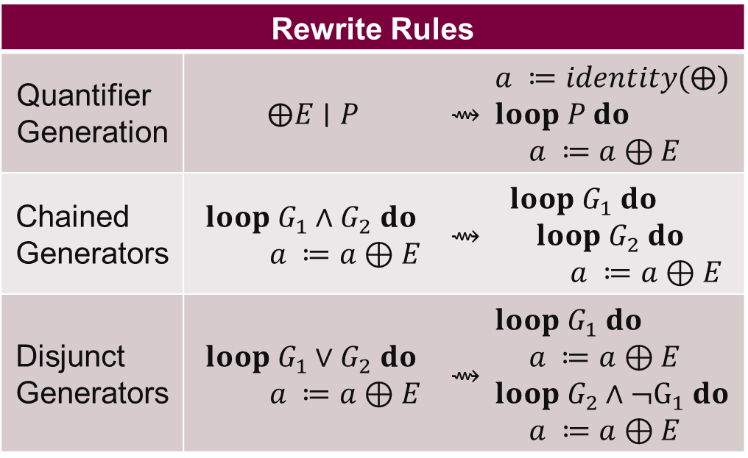
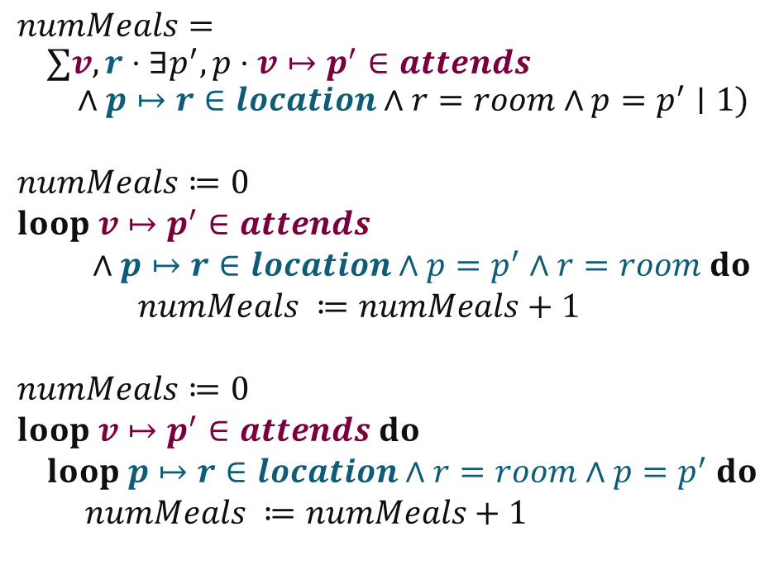
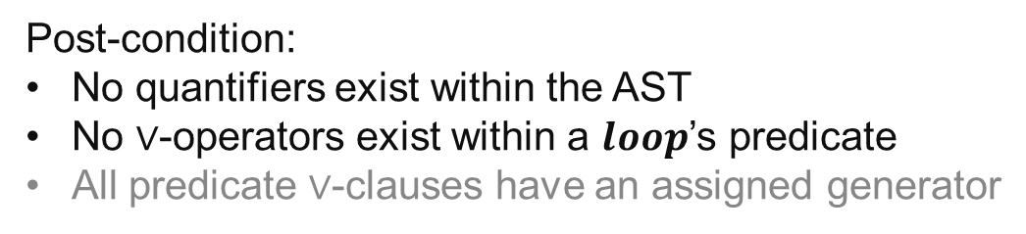

Phase 3: Loop Lowering
Start lowering expressions into imperative-like loops
Rewrite Rules
Quantifier Generation | $$⨁E∣P$$ | $$⇝$$ | $$a ≔identity(⨁)$$ $$loop P do$$ $a ≔a⊕E$
Chained Generators | $$loop G_{1}∧G_{2} do$$ $$a ≔a⊕E$$ | $$⇝$$ | $$loop G_{1} do \\ loop G_{2} do$$ $a ≔a⊕E$
Disjunct Generators | $$loop G_{1}∨G_{2} do$$ $$a ≔a⊕E$$ | $$⇝$$ | $$loop G_{1} do$$ $$a ≔a⊕E \\ loop G_{2}∧¬G_{1} do$$ $a ≔a⊕E$
$⊕$ is any of $\left\{…\right\}, Σ, Π, ∪, ∩$
$$numMeals= \\ ∑v,r⋅∃p^{′},p⋅v↦p^{′}∈attends \\ ∧p↦r∈location∧r=room∧p=p^{′}∣1)$$
$$numMeals≔0 \\ loop v↦p^{′}∈attends \\ ∧p↦r∈location∧p=p^{′}∧r=room do \\ numMeals ≔numMeals+1$$
$$numMeals≔0 \\ loop v↦p^{′}∈attends do \\ loop p↦r∈location∧r=room∧p=p^{′} do \\ numMeals ≔numMeals+1$$
Quantifier Generation
Chained Generators
Post-condition:
No quantifiers exist within the AST
No $∨$-operators exist within a $loop$’s predicate
All predicate $∨$-clauses have an assigned generator
Notes:
Start code generation,
Quantifiers are lowered into loops (nested if need-be)
Note on disjunct generators:
splitting OR-clause predicates into sequential loop additions
Think of how unions are actually executed, still need that sequential pass through every relevant set
Addition of negation of previously added elements guarantees that there is no double counting
Especially useful for non-idempotent quantifiers (sum, product)
Need to consider chained/nested generators, like we have in our example
At this point in time, no quantifiers are left in the AST
They have all been lowered to loops
All loops have a single, assigned generator/iterable
Example:
<click>
Quantification is now in the Loop intermediate representation

Slide 16
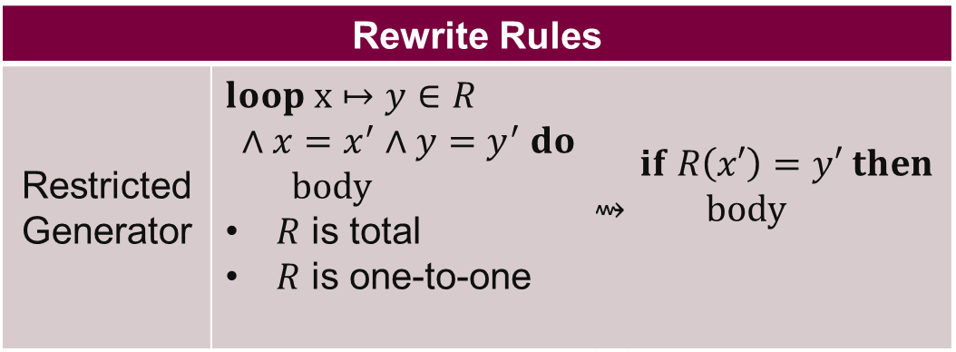
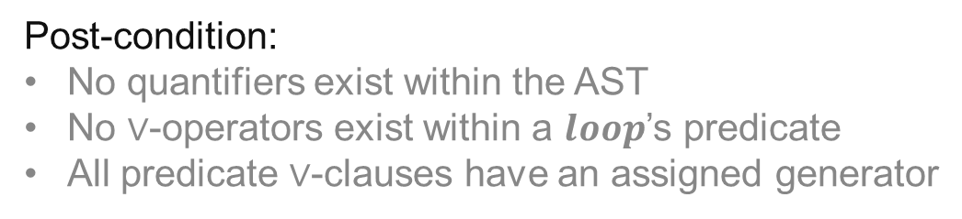
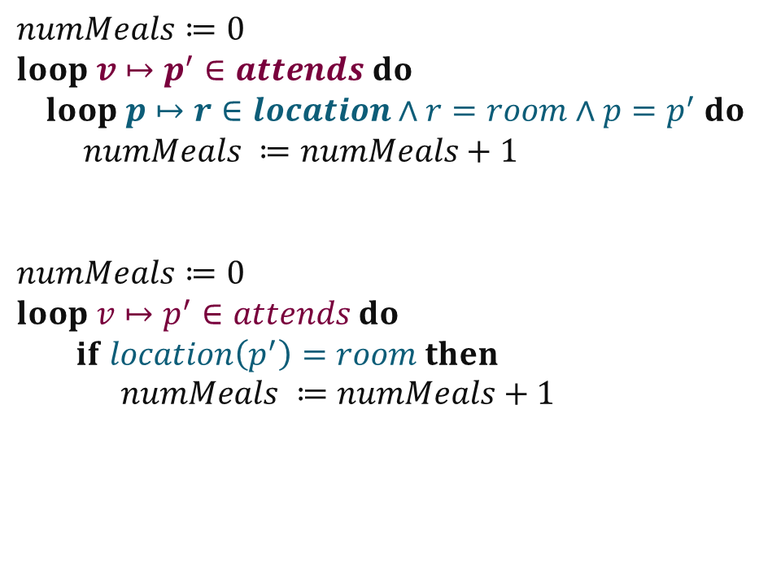
Phase 4: Relation Subtyping Loop Simplification
Eliminate unnecessary loops
Rewrite Rules
Restricted Generator | $$loop x↦y∈R \\ ∧x=x^{′}∧y=y^{′} do \\ body$$ $R$ is total $R$ is one-to-one | $$⇝$$ | $$if R\left(x′\right)=y′ then \\ body$$
One-to-one Total Function
$$numMeals≔0 \\ loop v↦p^{′}∈attends do \\ loop p↦r∈location∧r=room∧p=p^{′} do \\ numMeals ≔numMeals+1$$
$$numMeals≔0 \\ loop v↦p^{′}∈attends do \\ if location\left(p^{′}\right)=room then \\ numMeals ≔numMeals+1$$
Post-condition:
No quantifiers exist within the AST
No $∨$-operators exist within a $loop$’s predicate
All predicate $∨$-clauses have an assigned generator
Notes:
Remember, these data structures are for hash-based sets and relations (bimaps)
lookups and iterated lookups are the atomic hashmap operations
Only way to check each element of this concretized data structure
But we can still minimize the number of loops we need to actually execute using relational subtyping
We know the location relation is one-to-one and total
So we can reduce the inner loop to a single, direct lookup
We eliminate an entire loop because we know that p and r are restricted in their values
Normal programming languages do not have the semantics to allow this static analysis and optimization
There are many more optimization rules that can be made from:
totality on the relation range (surjectivity)
Domain restrictions (ex. Min/max value for a set of integers)

Slide 17
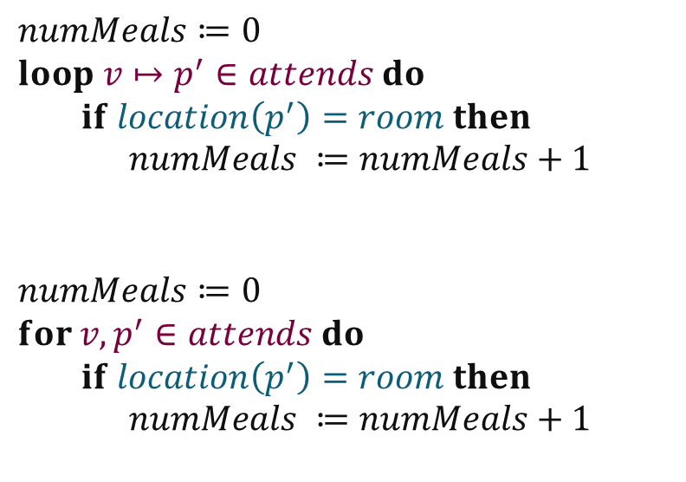
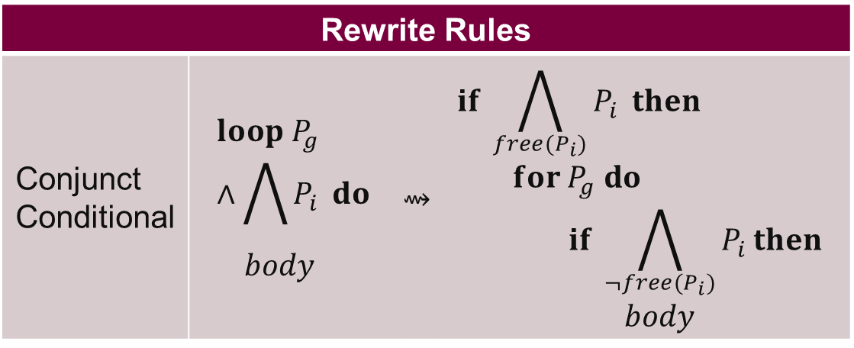
Phase 5: Loop Code Generation
Lower into imperative $loop$structures
Rewrite Rules
Conjunct Conditional | $$loop P_{g}∧\bigwedge{P_{i}} do$$ $$body$$ | $$⇝$$ | $$if \bigwedge_{{free(P}_{i})}{P_{i}} then$$ $$for P_{g} do$$ $$if \bigwedge_{{¬free(P}_{i})}{P_{i}}then$$ $$body$$
$$numMeals≔0 \\ loop v↦p^{′}∈attends do \\ if location\left(p^{′}\right)=room then \\ numMeals ≔numMeals+1$$
$$numMeals≔0 \\ for v,p^{′}∈attends do \\ if location\left(p^{′}\right)=room then \\ numMeals ≔numMeals+1$$
Post-condition:
Code is imperatively executable
Notes:
Lower our loop construct to a concrete for loop
Add condition checks for predicates that either need to be in or out of the loop scope
Code is executable in an imperative environment but may have undefined values
Example:
Generators become for loops, all other predicates become if statements
We have a perfectly functional imperative program with NO Intermediate sets!
Other phases are needed in practice, but the system provided is enough to cover the specific composition, inverse, and lookup operations for the visitor information system

Slide 18
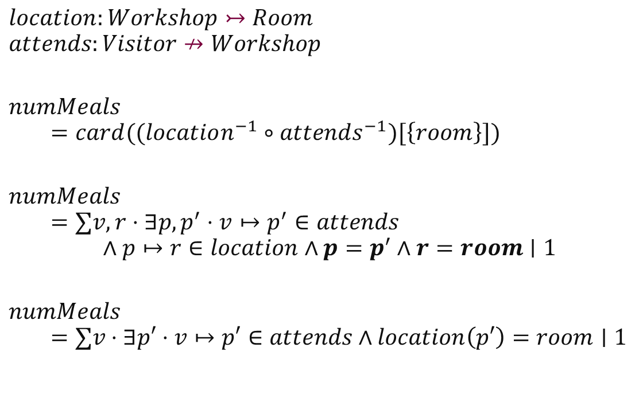

Visitor Information System - Translation
One-to-One Total Function
$$location:Workshop↣Room$$
$$attends:Visitor↛Workshop$$
$$numMeals$$
$$=card((location^{−1}∘attends^{−1})[\left\{room\right\}])$$
$$numMeals$$
$$=∑v,r⋅∃p,p^{′}⋅v↦p^{′}∈attends \\ ∧p↦r∈location∧p=p^{′}∧r=room∣1$$
$$numMeals$$
$$=∑v⋅∃p′⋅v↦p′∈attends∧location\left(p′\right)=room∣1$$
$$numMeals≔0 \\ for v,p′∈attends do \\ if location(p^{′})=room then \\ numMeals≔numMeals+1$$
Notes:
Review the original example one more time
Backtrack to the original equation
R does not need to be iterated by this sum, since it is already restricted by an external value (the input room)
P and p’ are also equalities,
And location is a one-to-one function
so we can:
<click>
Eliminate them from the predicate
And then lower this to much more time efficient code
<click>
The transformation from set theory notation to code is only possible through manipulation of set-theory theorems
Basic requirements of these rules:
Objects and semantics must match that of set theory
No side effects
Use sets, rather than lambda calculus functions
We may need to provide the compiler with information on different kinds of relations
In this visitor information system, we could only shorten location because we knew it was a function
In this case, one-to-one and total

Slide 19
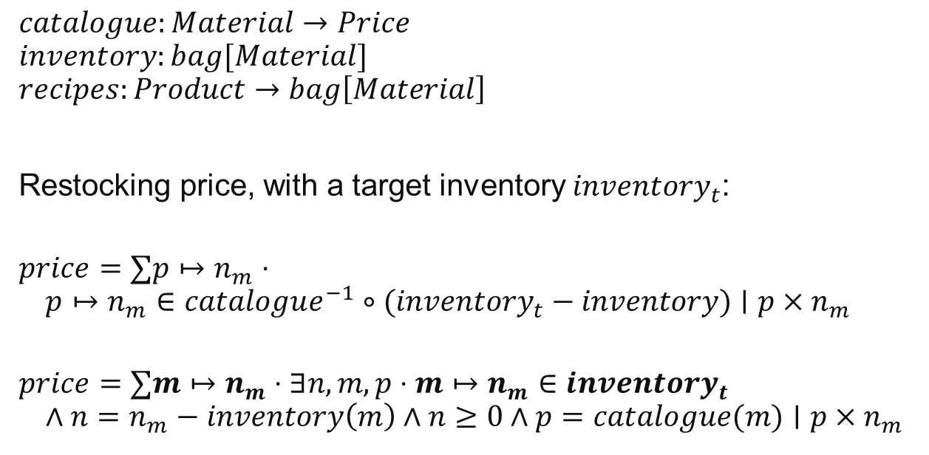
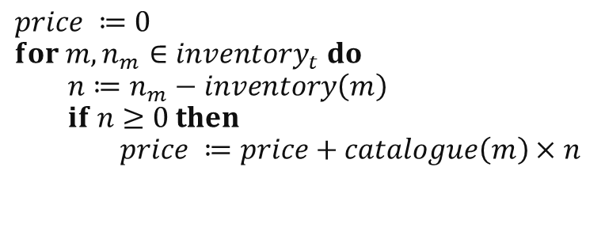
Warehouse Inventory System – Translation
Many-to-One Total Function
$$catalogue:Material→Price$$
$$inventory:bag[Material]$$
$$recipes:Product→bag\left[Material\right]$$
Restocking price, with a target inventory $inventory_{t}$:
$$price=∑p↦n_{m}⋅ \\ p↦n_{m}∈catalogue^{−1}∘{(inventory}_{t} − inventory)∣p×n_{m}$$
$$price=∑m↦n_{m}⋅∃n,m,p⋅m↦n_{m}∈{inventory}_{t} \\ ∧n=n_{m}−inventory\left(m\right)∧n≥0∧p=catalogue(m)∣p×n_{m}$$
Many-to-One Function
$$price ≔0 \\ for m,n_{m}∈inventory_{t} do \\ n≔n_{m}−inventory\left(m\right) \\ if n≥0 then \\ price ≔price+catalogue\left(m\right)×n$$
Notes:
Circling back to the warehouse inventory, let’s take another look at the restocking price sum
<click>
This composition can be rewritten in a similar way to the visitor information system
<click>
Translating this to code, we eagerly check that all conditions are met before continuing to the summation phase

Slide 20
Preliminary Results
Intermediate sets never grow larger than max(starting sets, resulting set)
Unions, Relation Overriding, and Cartesian Products are limited in growth
Other operators only decrease the size of a resulting set
What about running time?…
Notes:
Intermediate sets never grow larger than max(starting sets, resulting set)
With more type information on the size and range of sets, we can ensure a good choice of starting set
Unions, Relation Overriding, and Cartesian Products are limited in growth by the handling of predicates within the rewriting system
All other operators only decrease the size of a resulting set
Applied as conditions of membership at set construction time
<click>
What about running time?…

Slide 21
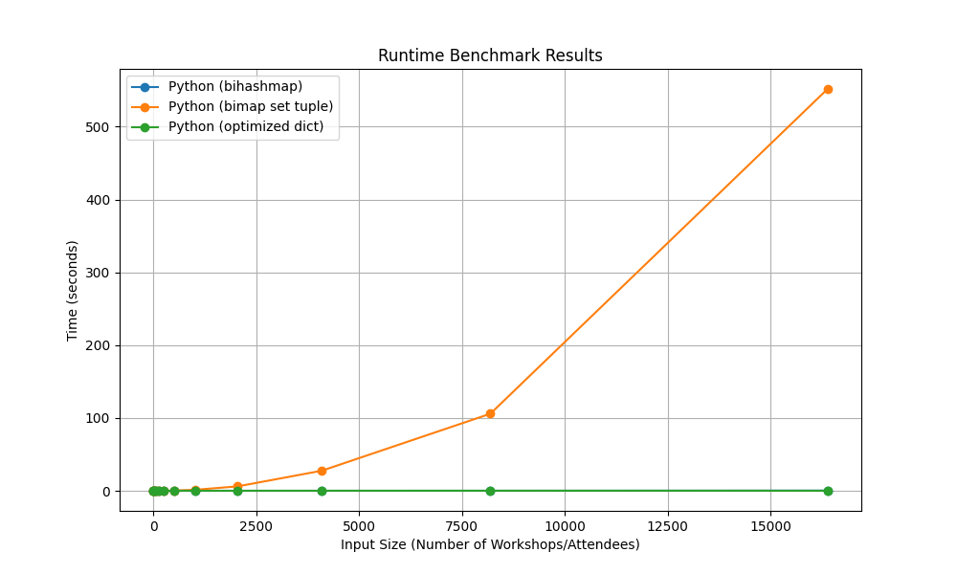
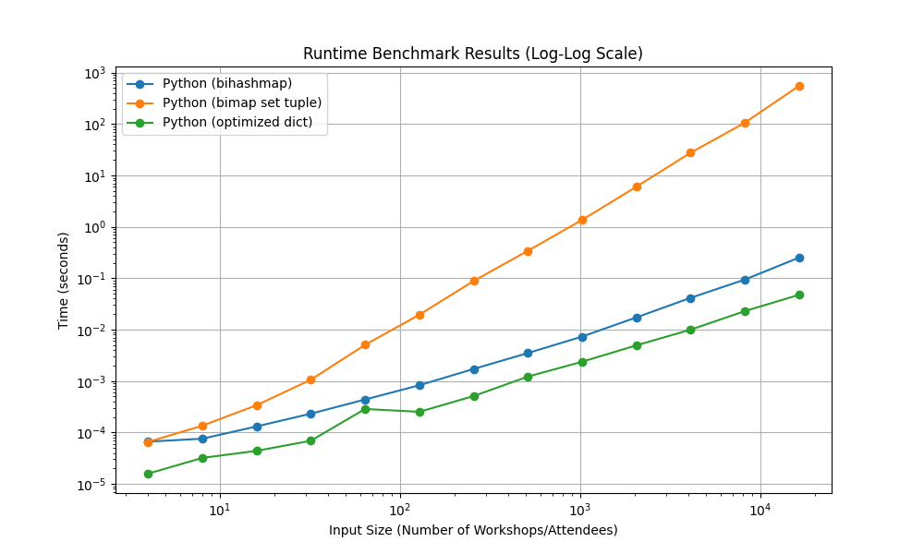
Visitor Information System Benchmark – Runtime
Notes:
We examine 3 different implementations of the visitor information system
Orange uses the set of tuples data set and relevant library functions
N^2 composition shows itself clearly
Blue contains the bidirectional hashmap implementation
Contains two hashmaps where the values are lists of values
It can handle all types of relations, but additional indirection takes up more space and is slower in practice
Our compiler generates the green version
Type system tells us that the two relations are only ever many-to-one or one-to-one
So we choose a simple hashmap as the underlying implementation
Executing function is the same as the one discussed in the rewriting system slides

Slide 22
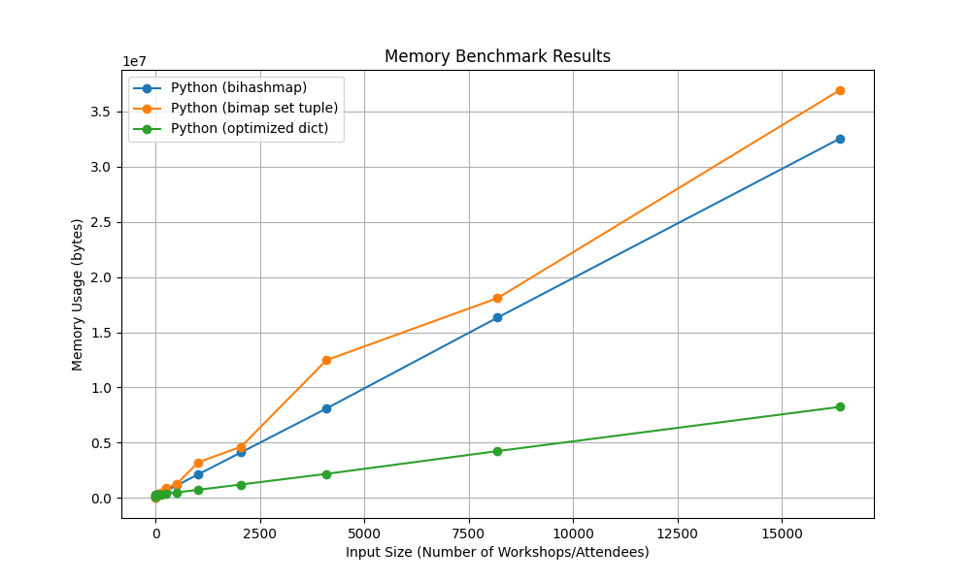
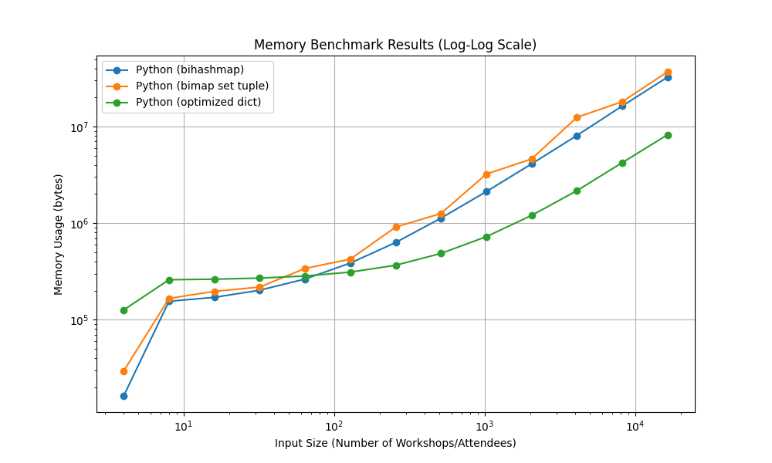
Visitor Information System Benchmark – Memory Consumption
Notes:
Log-Log scale has more to do with python’s internal implementation of these data types than the choice of datatype
But its obvious that being able to refine our relation type into a many-to-one relation
Which allows us to choose the hashmap as an underlying representation
Saves on space that would otherwise be needed for more complex relationships

Slide 23
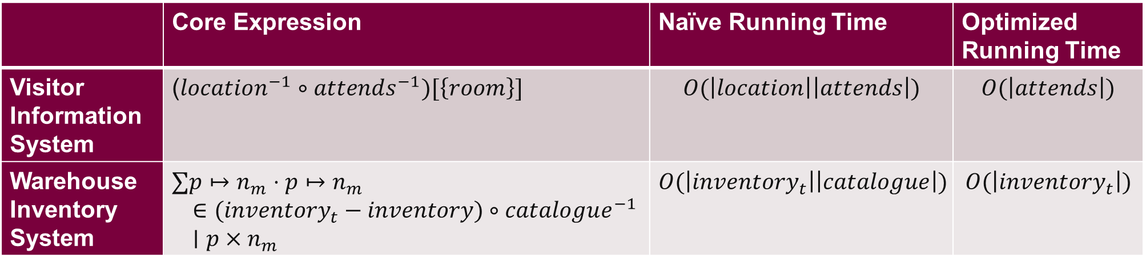
Examples Running Time
 | Core Expression | Naïve Running Time | Optimized Running Time
Visitor Information System | ($location^{−1}∘attends^{−1})[\left\{room\right\}]$ | $$O(\left|location\right|\left|attends\right|)$$ | $$O(\left|attends\right|)$$
Warehouse Inventory System | $$∑p↦n_{m}⋅p↦n_{m} \\ ∈{(inventory}_{t} − inventory)∘catalogue^{−1} \\ ∣p×n_{m}$$ | $$O(\left|inventory_{t}\right|\left|catalogue\right|)$$ | $$O(\left|inventory_{t}\right|)$$
Notes:
In both the Visitor Information and Warehouse Inventory system, intermediate constructions of relation composition could consume O(n^2) running time.
However, knowing how the relations will be used enables us to iterate over only one of those relations
Both catalogue and location are functions, thus we know that every element in the domain can only appear once
Querying into these relations only return one value

Slide 24
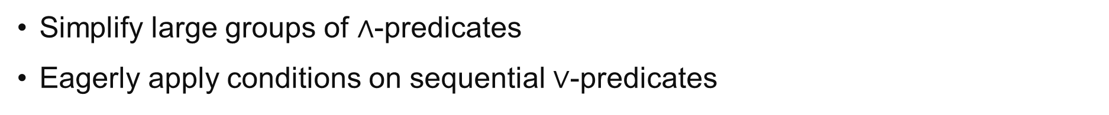
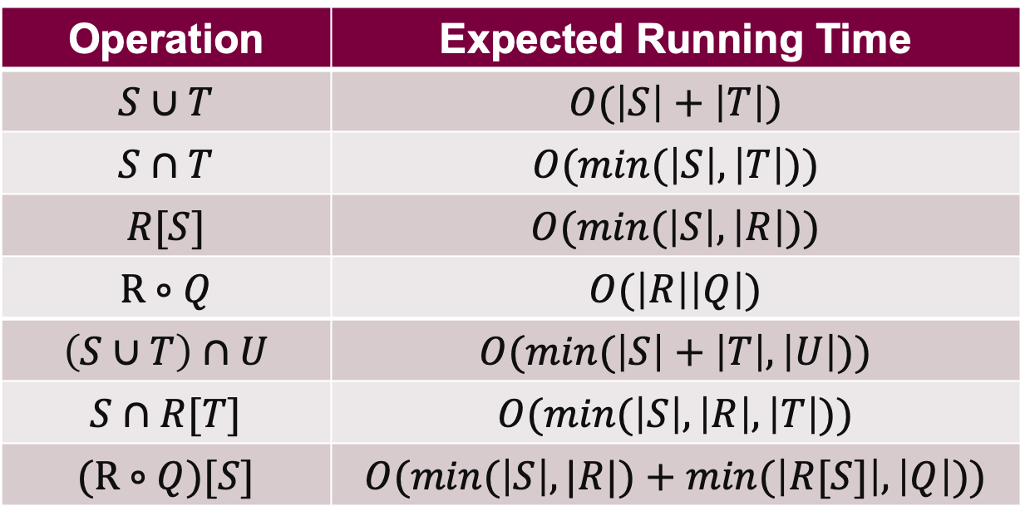
Operation Running Time With (Bi-directional) HashMaps
Operation | Expected Running Time
$$S∪T$$ | $$O(\left|S\right|+\left|T\right|)$$
$$S∩T$$ | $$O(min⁡(\left|S\right|,\left|T\right|))$$
$$R[S]$$ | $$O(min⁡(\left|S\right|,\left|R\right|))$$
$$\text{R}∘Q$$ | $$O(\left|R\right|\left|Q\right|)$$
$$\left(S∪T\right)∩U$$ | $$O(min⁡(\left|S\right|+\left|T\right|, \left|U\right|))$$
$$S∩R[T]$$ | $$O(min⁡(\left|S\right|,\left|R\right|,\left|T\right|))$$
$$\text{(}\text{R}∘Q)[S]$$ | $$O(min⁡(\left|S\right|, |R|)+min⁡(\left|R[S]\right|, \left|Q\right|))$$
Simplify large groups of $∧$-predicates
Eagerly apply conditions on sequential $∨$-predicates
Notes:
We can effectively lower the running time of those previous operators if we spot convenient context that limits the need for full loop iterations
Relation composition may be reduced to linear running time, like we saw with the visitor information example
What do we look for?
To optimize running time:
Simplify large groups of $∧$-predicates
Catch those extra conditions early
To optimize memory usage
Eagerly apply conditions on sequential $∨$-clause predicates
These are just the general behaviour of the examples seen using these operators, more refined definitions will follow!

Slide 25
Current Compiler State and Roadmap
Development of a High-Level, Efficient, Set-Based Language
Optimizing Rewrite Rules
Code Generation (MLIR/LLVM)
Model Simulation Specification
Concurrency Optimizations: SIMD, Data Parallelism
Data Type Lowering
Notes:
Current state of compiler
a prototype of set and relation based rewrites, working on adding full support for relational type refinements
Preliminary code generation to rust (to test that our rewrite rules actually compile to an imperative program)
Data type lowering *only for hashmaps*
Future work
Continue research on more concrete data type representations that optimize for specific operations
Need to create rewrite rules to target different “atomic” operations for the chosen data type
Target LLVM, likely through the MLIR ecosystem
Right now the rewrite rules are written through match statements in python (quick but not ergonomic)
MLIR dialects could be the solution we are looking for
Ensure efficient code generation that covers low-level optimizations
Supported on numerous platforms
Addition of concurrency optimizations in other work by our group, with the end goal being a high level, simple, fast language
If we change the way we think about programming, we can assist our compilers in doing more of the programming work for us

Slide 26
References
Michael Leuschel. ProB2 Jupyter Notebooks GitLab. 2020. https://gitlab.cs.uni-duesseldorf.de/general/stups/prob2-jupyter-notebooks/-/blob/9d830112d9713d0cbc12d9d285f44ee61c827ccf/puzzles/Game_of_Life.ipynb
Jean-Raymond Abrial. Modeling in Event-B: system and software engineering. Cambridge University Press, 2010.
David Gries and Fred Schneider. A Logical Approach to Discrete Math. Springer New York, 1993.
Robert Dewar. The SetL Programming Language. Bell Laboratories, 1979.
Simon Peyton Jones, Andrew Tolmach, and Tony Hoare. Playing by the rules: rewriting as a practical optimisation technique in GHC. In: 2001 Haskell Workshop. ACM SIGPLAN. Sept. 2001.
Michael Leuschel. Programming in B: Sets and Logic all the Way Down. In: LPOP 2022.
Maximiliano Cristia and Gianfranco Rossi. {log}: Programming and Automated Proof in Set Theory. In: LPOP 2022.
Douglas R. Smith and Stephen J. Westfold. Transformations for Generating Type Refinements. In: Formal Methods. FM 2019 International Workshops. Springer International Publishing, 2020, pp. 371-387
Edmond Schonberg, Jacob T. Schwartz, and Micha Sharir. 1979. Automatic data structure selection in SETL. In Proceedings of the 6th ACM SIGACT-SIGPLAN symposium on Principles of programming languages (POPL '79). Association for Computing Machinery, New York, NY, USA, 197–210. https://doi.org/10.1145/567752.567771
Stefan M. Freudenberger, Jacob T. Schwartz, and Micha Sharir. 1983. Experience with the SETL Optimizer. ACM Trans. Program. Lang. Syst. 5, 1 (Jan. 1983), 26–45. https://doi.org/10.1145/357195.357197

